Slide 2
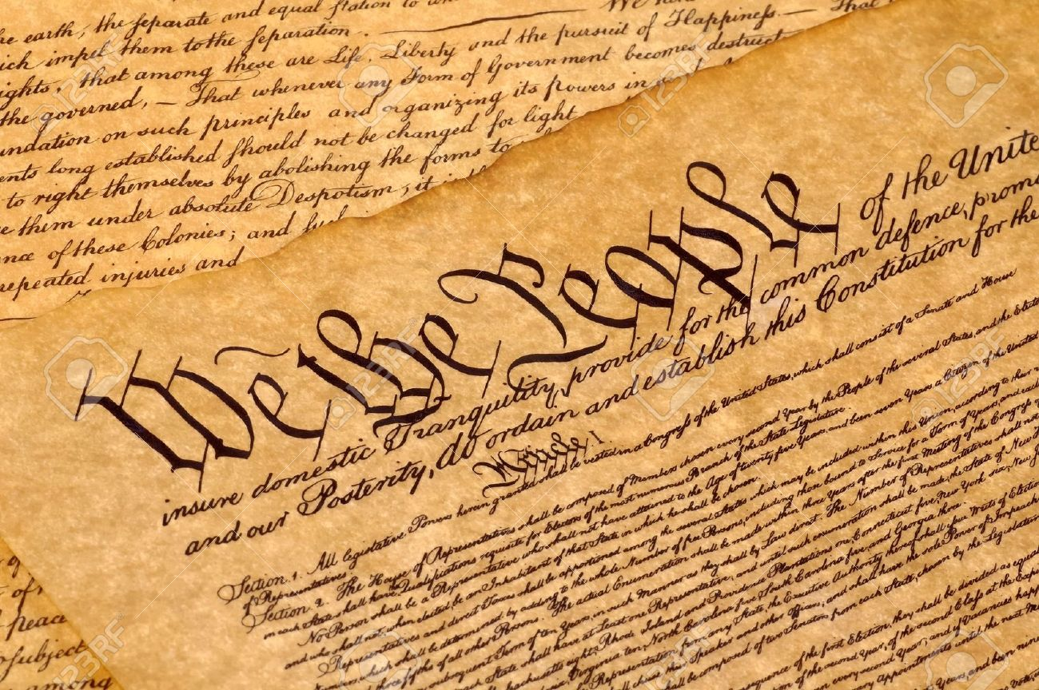

Slide 3
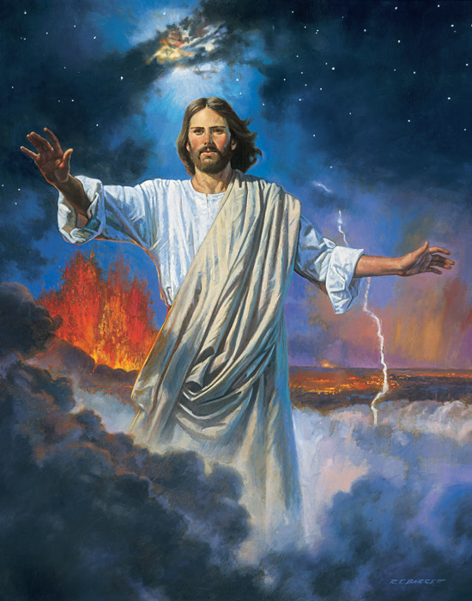
⁹ The true light, which gives light to everyone, was coming into the world.
¹⁰ He was in the world, and the world was made through him, yet the world did not know him.
¹¹ He came to his own, and his own people did not receive him.
¹² But to all who did receive him, who believed in his name, he gave the right to become children of God,
¹³ who were born, not of blood nor of the will of the flesh nor of the will of man, but of God.
^{John 1:9-13}

Slide 4
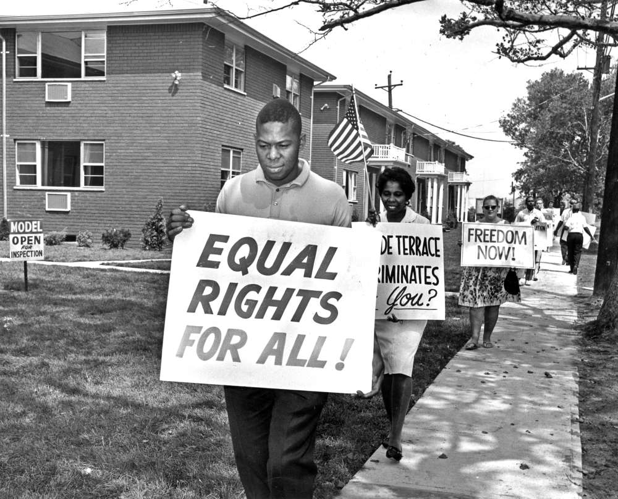
“The Right to Become Children of God!”

Slide 5
Dear Preacher . . .

Slide 6
⁹ The true light, which gives light to everyone, was coming into the world.
¹⁰ He was in the world, and the world was made through him, yet the world did not know him.
¹¹ He came to his own, and his own people did not receive him.
¹² But to all who did receive him, who believed in his name, he gave the right to become children of God,
¹³ who were born, not of blood nor of the will of the flesh nor of the will of man, but of God.
^{John 1:9-13}

Slide 9
⁹ The true light, which gives light to everyone, was coming into the world.
¹⁰ He was in the world, and the world was made through him, yet the world did not know him.
¹¹ He came to his own, and his own people did not receive him.
¹² But to all who did receive him, who believed in his name, he gave the right to become children of God,
¹³ who were born, not of blood nor of the will of the flesh nor of the will of man, but of God.
^{John 1:9-13}

Slide 10
⁹ The true light, which gives light to everyone, was coming into the world.
¹⁰ He was in the world, and the world was made through him, yet the world did not know him.
¹¹ He came to his own, and his own people did not receive him.
¹² But to all who did receive him, who believed in his name, he gave the right to become children of God,
¹³ who were born, not of blood nor of the will of the flesh nor of the will of man, but of God.
^{John 1:9-13}

Slide 13
How is it that you DON’T get born into God’s Family?
“not of blood”
“not of flesh”
“not of man’s will”

Slide 15
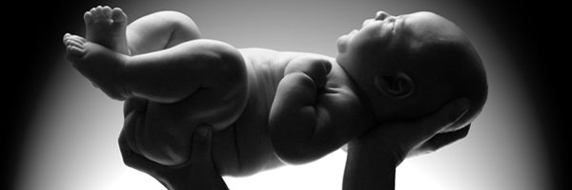
Born of God
“ . . . the action of the father
in creating children”

Slide 16
¹² But to all who did receive him, who believed in his name, he gave the right to become children of God,
¹³ who were born, not of blood nor of the will of the flesh nor of the will of man, but of God.
^{John 1:9-13}

Slide 17
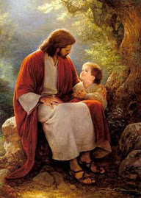

Slide 18
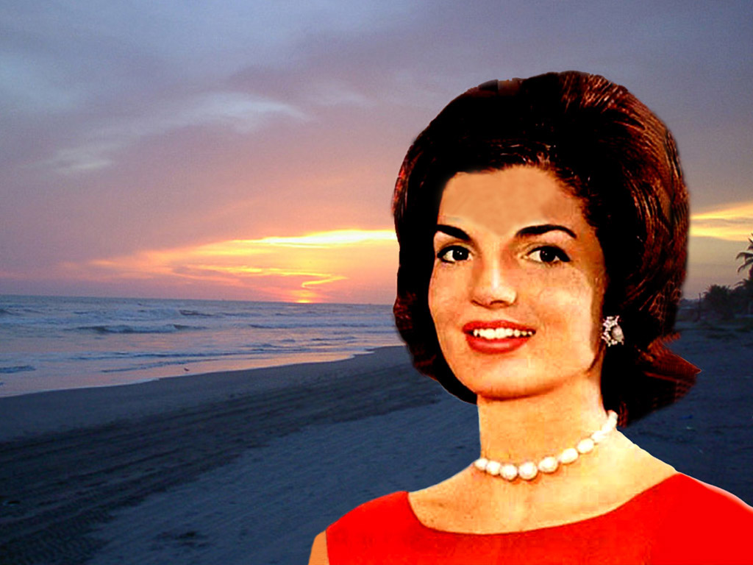
Jacqueline
Kennedy
Onassis

Slide 19
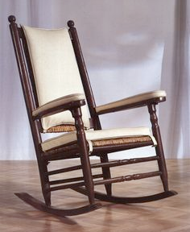
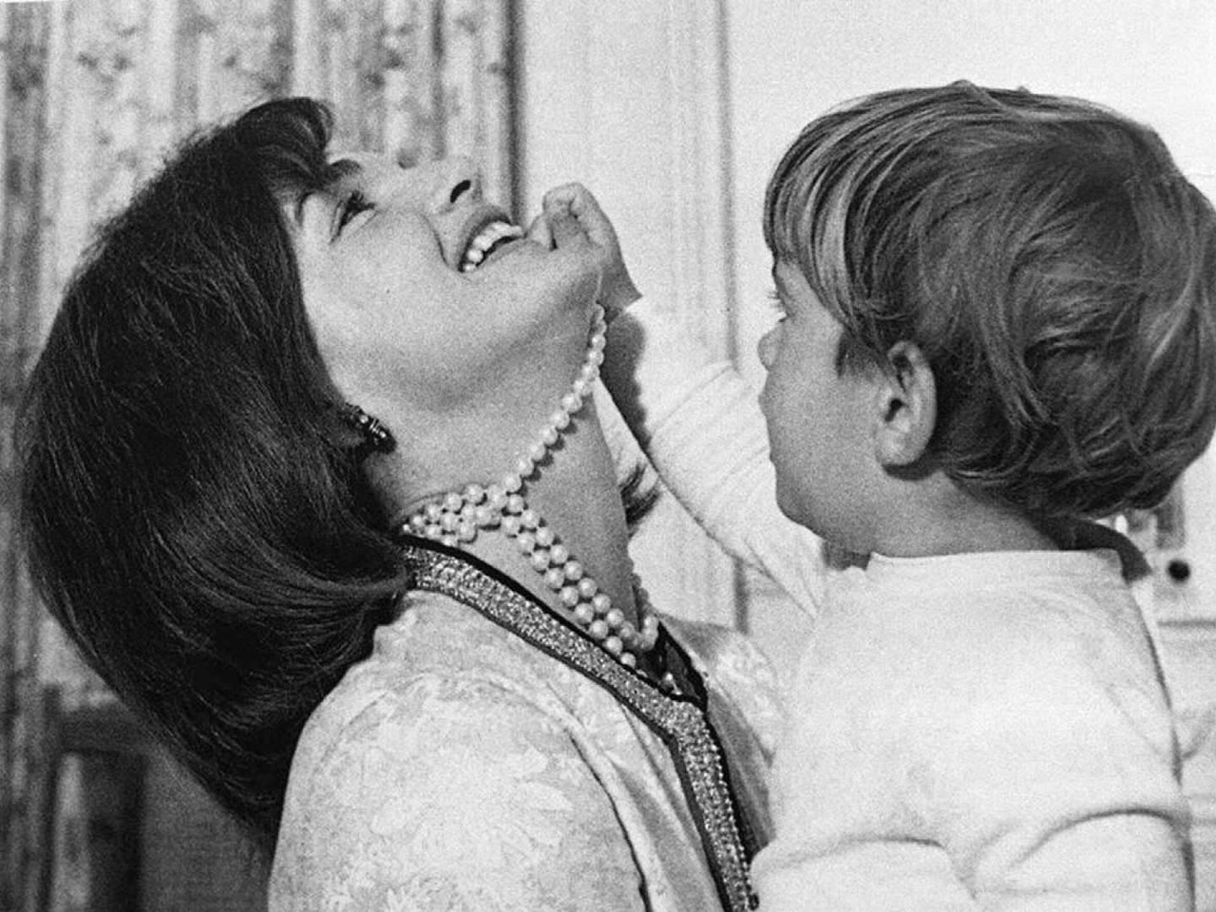
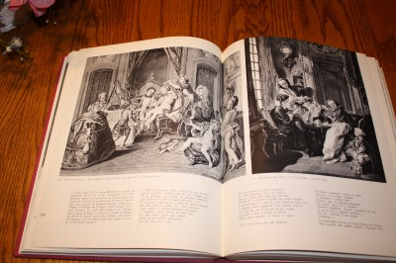

Slide 20
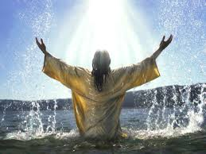
You have the right to become a child of God – to take on the name of Jesus.
It is your right from God.
Receive Jesus in obedient faith!

