Slide 2
“THIS IS FOR ALL
THE MOTHERS”

Slide 3
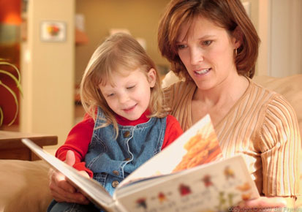
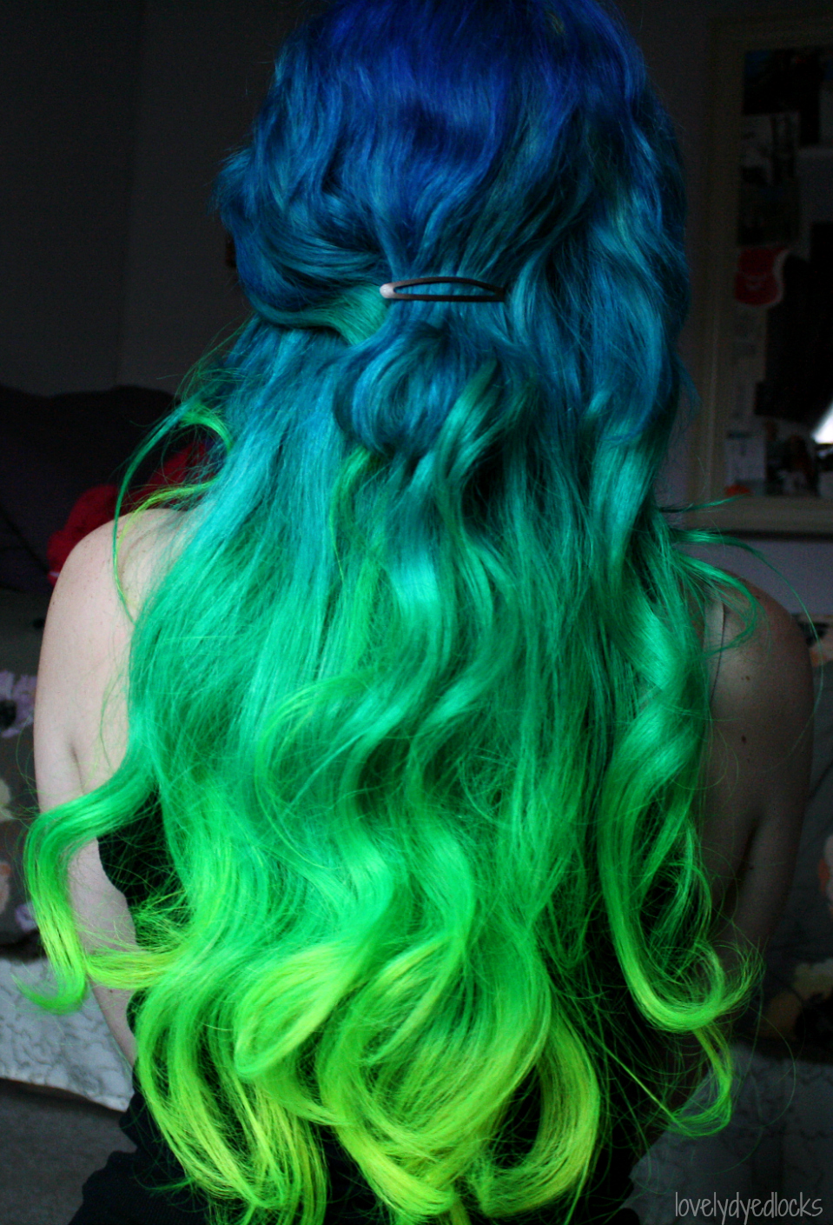

Slide 4
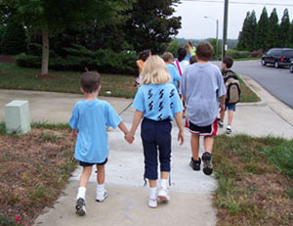
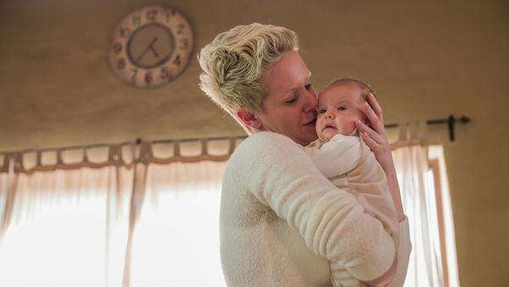

Slide 8
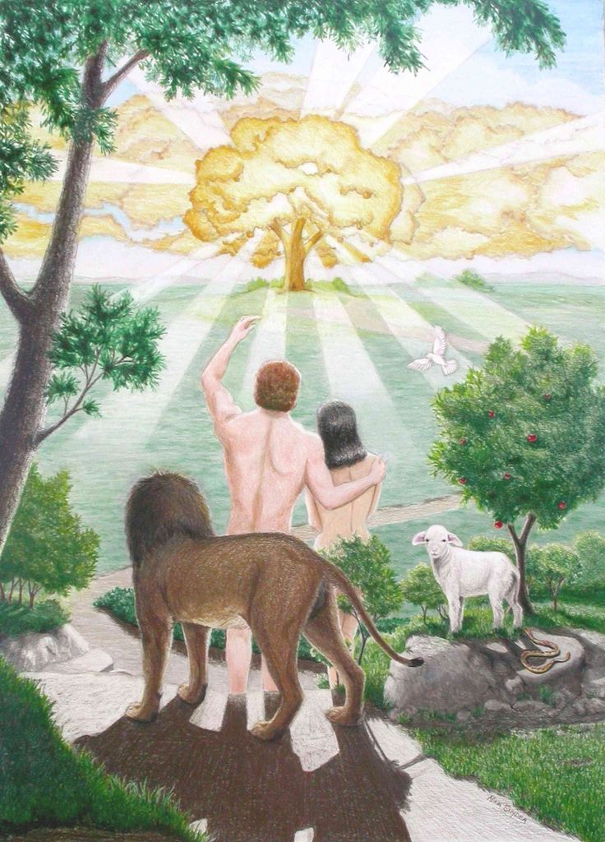
She is given her name . . . and it is a perfect name!
Her name means “LIFE”. Adam names his wife “life” – because she would be the mother of all those who have life.
What a perfect name for a mother – LIFE!

Slide 9
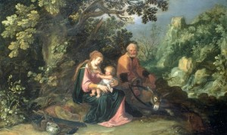
Why “LIFE” is a perfect name for a mother:
Because she grants physical life to her children.

Slide 10
Why “LIFE” is a perfect name for a mother:
2) Because she blesses her husband with completeness.

Slide 11
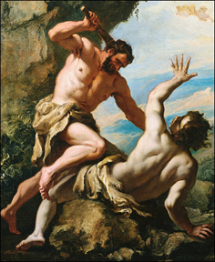
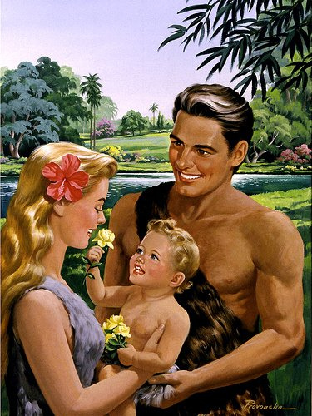
Why “LIFE” is a perfect name for a mother:
3) Because she is the great nurturer of the home.

Slide 12
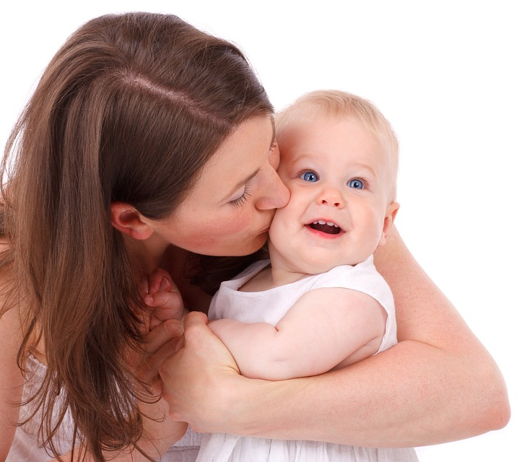
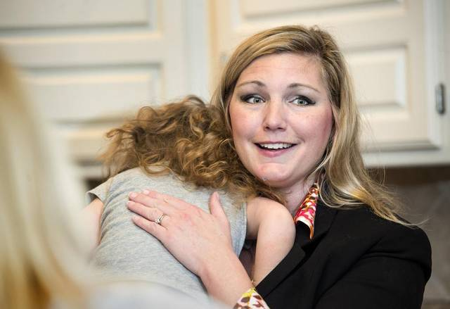
Why “LIFE” is a perfect name for a mother:
4) Because she fosters spiritual life in her children.

Slide 13
Why “LIFE” is a perfect name for a mother:
Because she grants physical life to her children.
2) Because she blesses her husband with completeness.
3) Because she is the great nurturer of the home.
4) Because she fosters spiritual life in her children.

Slide 14
“How Moms
Were Made”

