Slide 2
Where do you find peace?

Slide 4
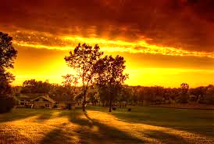

Slide 5
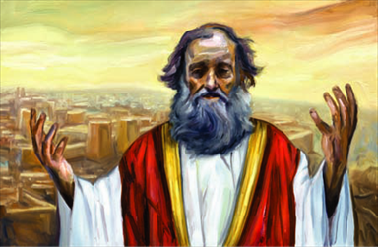
“Woe to those who cry ‘Peace! Peace!’ . . .

Slide 6
. . . when there is no peace.”

Slide 7
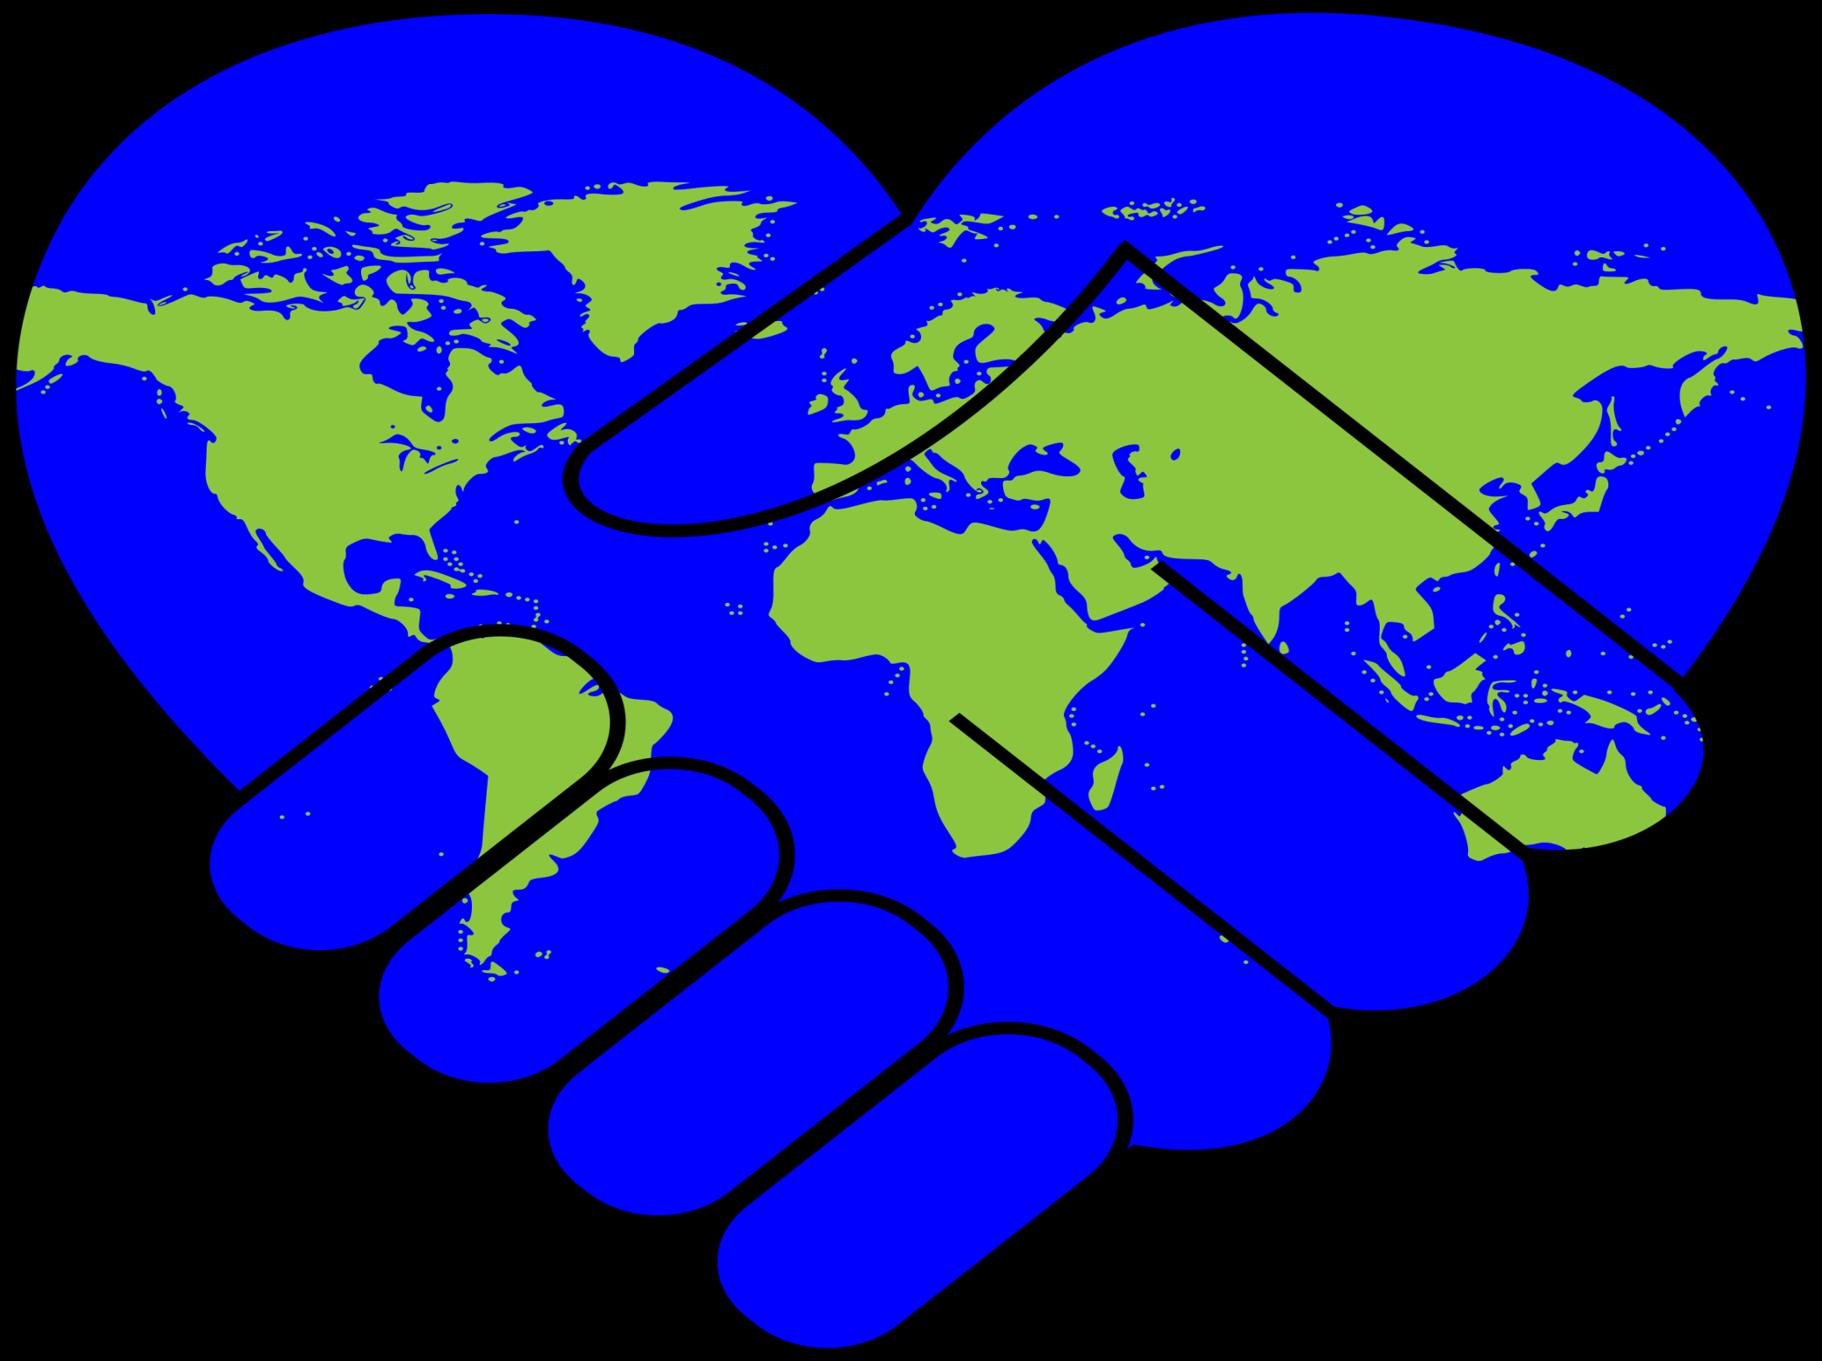

Slide 8
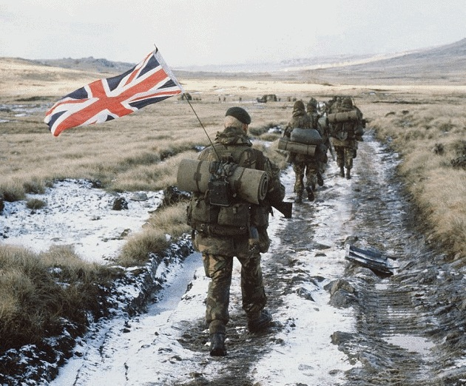

Slide 9
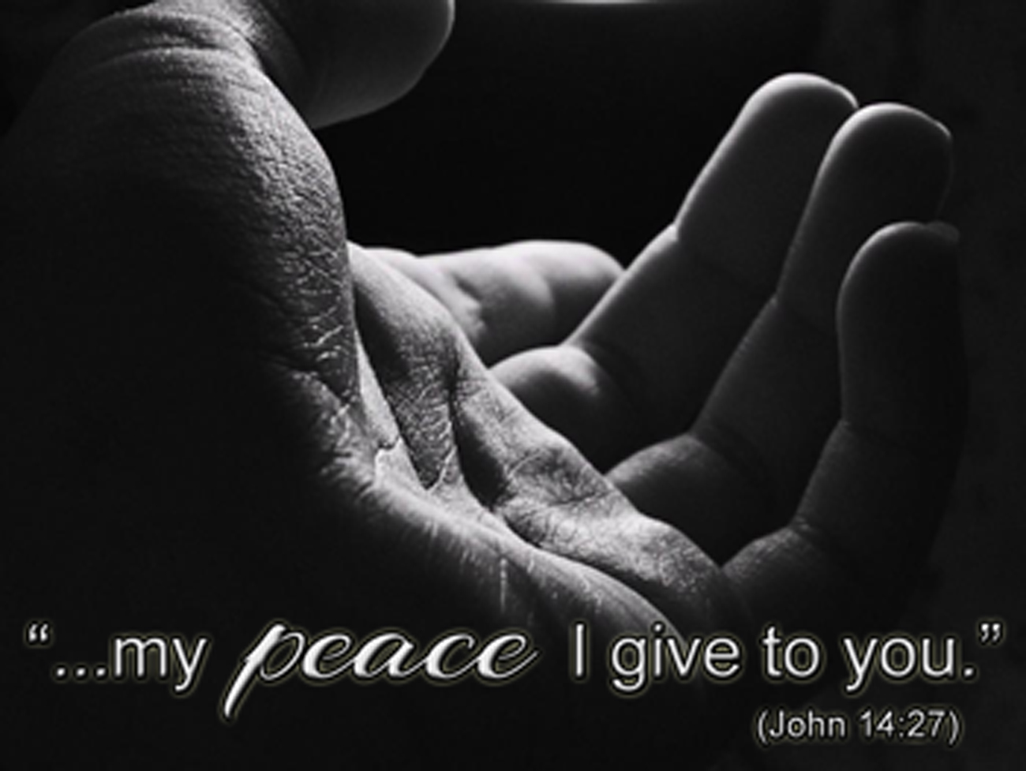

Slide 11
Colossians 1:15-20 (ESV)
The Preeminence of Christ
¹⁵He is the image of the invisible God, the firstborn of all creation. ¹⁶For by him all things were created, in heaven and on earth, visible and invisible, whether thrones or dominions or rulers or authorities—all things were created through him and for him. ¹⁷And he is before all things, and in him all things hold together. ¹⁸And he is the head of the body, the church. He is the beginning, the firstborn from the dead, that in everything he might be preeminent. ¹⁹For in him all the fullness of God was pleased to dwell, ²⁰and through him to reconcile to himself all things, whether on earth or in heaven, making peace by the blood of his cross.

Slide 12
Colossians 1:15-20 (ESV)
¹⁵He is the image of the invisible God, the firstborn of all creation. ¹⁶For by him all things were created, in heaven and on earth, visible and invisible, whether thrones or dominions or rulers or authorities—all things were created through him and for him. ¹⁷And he is before all things, and in him all things hold together. ¹⁸And he is the head of the body, the church. He is the beginning, the firstborn from the dead, that in everything he might be preeminent. ¹⁹For in him all the fullness of God was pleased to dwell, ²⁰and through him to reconcile to himself all things, whether on earth or in heaven, making peace by the blood of his cross.

Slide 13
Colossians 1:15-20 (ESV)
¹⁵He is the image of the invisible God, the firstborn of all creation. ¹⁶For by him all things were created, in heaven and on earth, visible and invisible, whether thrones or dominions or rulers or authorities—all things were created through him and for him. ¹⁷And he is before all things, and in him all things hold together. ¹⁸And he is the head of the body, the church. He is the beginning, the firstborn from the dead, that in everything he might be preeminent. ¹⁹For in him all the fullness of God was pleased to dwell, ²⁰and through him to reconcile to himself all things, whether on earth or in heaven, making peace by the blood of his cross.

Slide 14
Colossians 1:15-20 (ESV)
¹⁵He is the image of the invisible God, the firstborn of all creation. ¹⁶For by him all things were created, in heaven and on earth, visible and invisible, whether thrones or dominions or rulers or authorities—all things were created through him and for him. ¹⁷And he is before all things, and in him all things hold together. ¹⁸And he is the head of the body, the church. He is the beginning, the firstborn from the dead, that in everything he might be preeminent. ¹⁹For in him all the fullness of God was pleased to dwell, ²⁰and through him to reconcile to himself all things, whether on earth or in heaven, making peace by the blood of his cross.

Slide 15
Colossians 1:15-20 (ESV)
¹⁵He is the image of the invisible God, the firstborn of all creation. ¹⁶For by him all things were created, in heaven and on earth, visible and invisible, whether thrones or dominions or rulers or authorities—all things were created through him and for him. ¹⁷And he is before all things, and in him all things hold together. ¹⁸And he is the head of the body, the church. He is the beginning, the firstborn from the dead, that in everything he might be preeminent. ¹⁹For in him all the fullness of God was pleased to dwell, ²⁰and through him to reconcile to himself all things, whether on earth or in heaven, making peace by the blood of his cross.

Slide 16
Colossians 1:19-20 (ESV)
¹⁹For in him all the fullness of God was pleased to dwell, ²⁰and through him to reconcile to himself all things, whether on earth or in heaven, making peace by the blood of his cross.

Slide 17
Colossians 1:19-20 (ESV)
¹⁹For in him all the fullness of God was pleased to dwell, ²⁰and through him to reconcile to himself all things, whether on earth or in heaven, making peace by the blood of his cross.

Slide 18
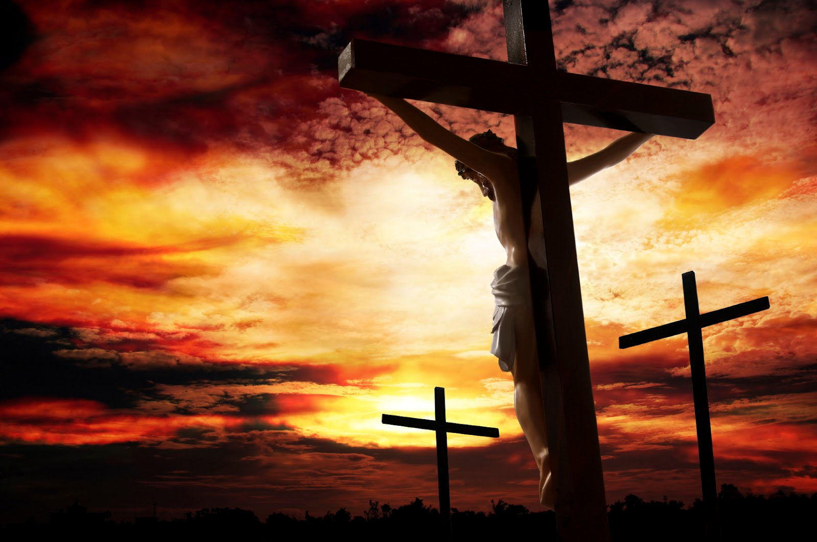

Slide 19
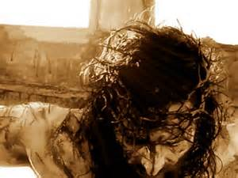

Slide 21
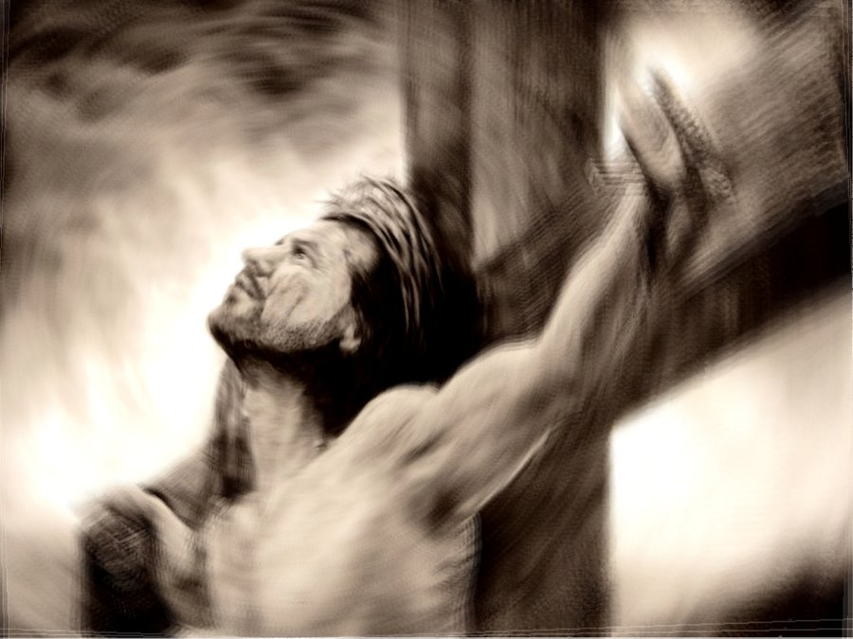
PEACE?

Slide 22
God made PEACE through the blood of Jesus’ cross.

Slide 24
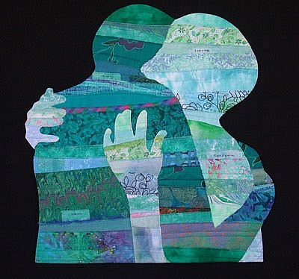
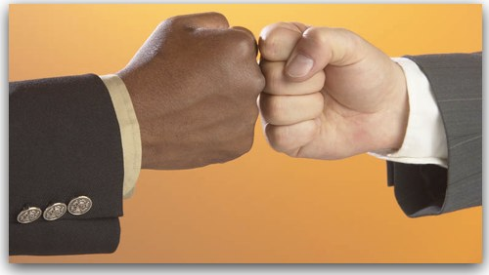

Slide 27
Colossians 1:19-20 (ESV)
²⁰and through him to reconcile to himself all things, whether on earth or in heaven, making peace by the blood of his cross.

Slide 28
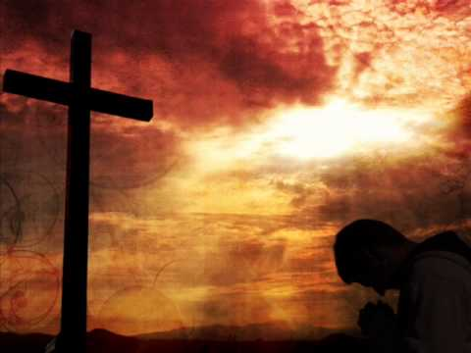
PEACE
“I Believe”
“I will trust and obey”

Slide 29
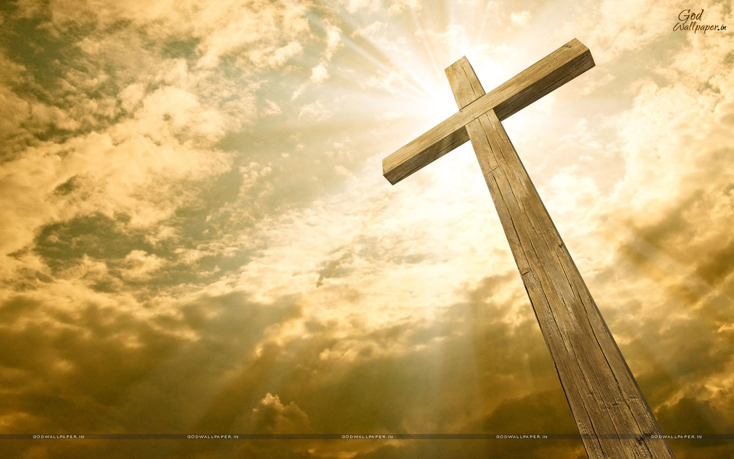

Slide 30
¹⁷ Therefore, if anyone is in Christ, he is a new creation. The old has passed away; behold, the new has come. ¹⁸ All this is from God, who through Christ reconciled us to himself and gave us the ministry of reconciliation; ¹⁹ that is, in Christ God was reconciling the world to himself, not counting their trespasses against them, and entrusting to us the message of reconciliation. ²⁰ Therefore, we are ambassadors for Christ, God making his appeal through us. We implore you on behalf of Christ, be reconciled to God. ²¹ For our sake he made him to be sin who knew no sin, so that in him we might become the righteousness of God.
2 Corinthians 5:17-21

