Slide 4
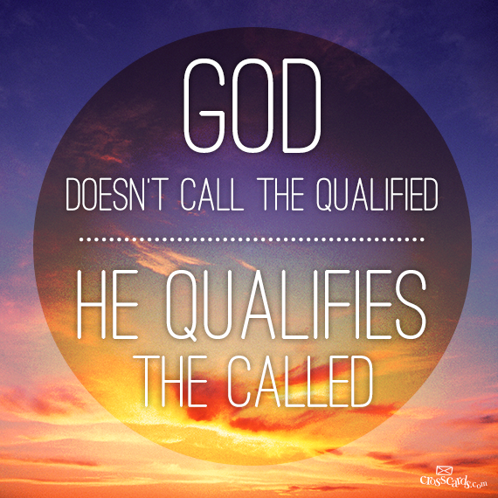

Slide 5
Colossians 2:18 (ESV)
¹⁸Let no one disqualify you, insisting on asceticism and worship of angels, going on in detail about visions, puffed up without reason by his sensuous mind,

Slide 6
Colossians 2:20-23 (ESV)
²⁰ If with Christ you died to the elemental spirits of the world, why, as if you were still alive in the world, do you submit to regulations—
²¹ “Do not handle, Do not taste, Do not touch”
²² (referring to things that all perish as they are used)—according to human precepts and teachings?
²³ These have indeed an appearance of wisdom in promoting self-made religion and asceticism and severity to the body, but they are of no value in stopping the indulgence of the flesh.

Slide 8
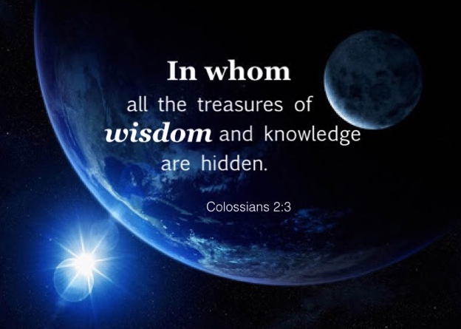

Slide 9
Colossians 2:20-23 (ESV)
²⁰ If with Christ you died to the elemental spirits of the world, why, as if you were still alive in the world, do you submit to regulations—
²¹ “Do not handle, Do not taste, Do not touch”
²² (referring to things that all perish as they are used)—according to human precepts and teachings?
²³ These have indeed an appearance of wisdom in promoting self-made religion and asceticism and severity to the body, but they are of no value in stopping the indulgence of the flesh.

Slide 10
Colossians 2:20-23 (ESV)
²⁰ If with Christ you died to the elemental spirits of the world, why, as if you were still alive in the world, do you submit to regulations—
²¹ “Do not handle, Do not taste, Do not touch”
²² (referring to things that all perish as they are used)—according to human precepts and teachings?
²³ These have indeed an appearance of wisdom in promoting self-made religion and asceticism and severity to the body, but they are of no value in stopping the indulgence of the flesh.

Slide 11
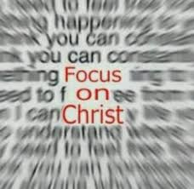

Slide 12
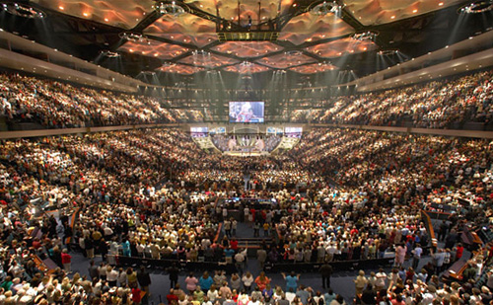

Slide 15
DO-IT-YOURSELF
Self-disciple
Self-help
Self-
awareness
Self-
actualization
Self-fulfillment
Self-esteem

Slide 17
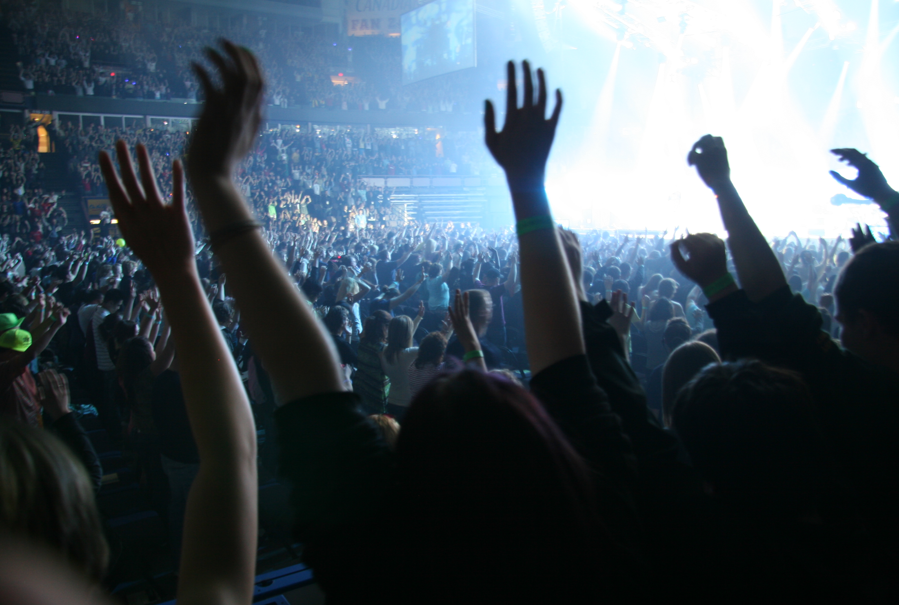
“Worship
Experiences”
The NEW is emphasized
over the TRUE!

Slide 18
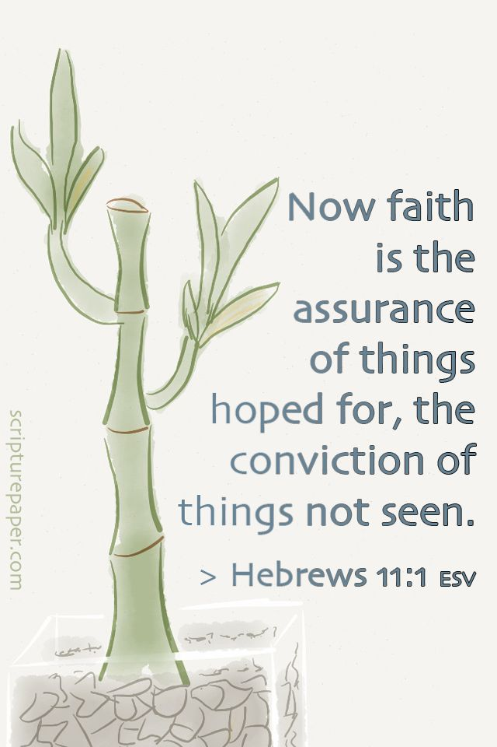

Slide 19
These have indeed an appearance of wisdom in promoting self-made religion and asceticism and severity to the body, but they are of no value in stopping the indulgence of the flesh.

Slide 20
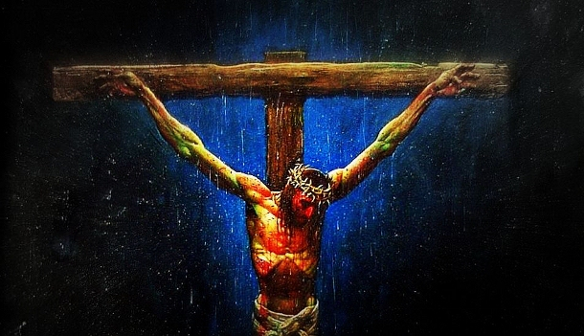

Slide 23
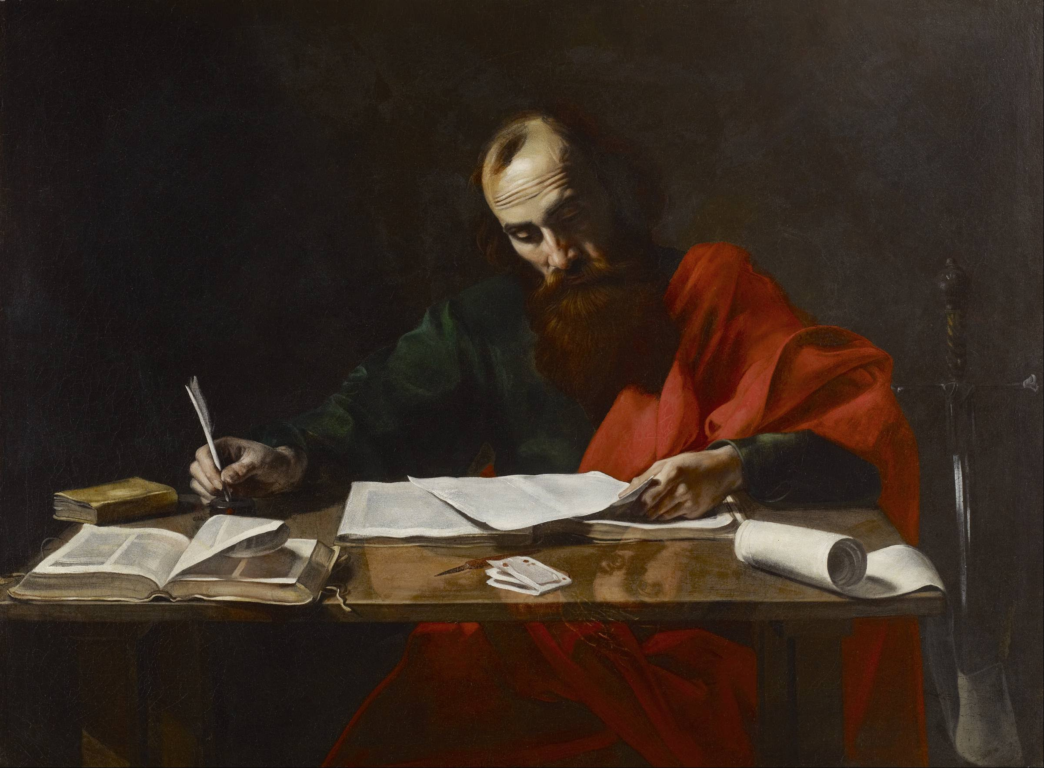
The Apostle Paul

Slide 24
