Slide 2
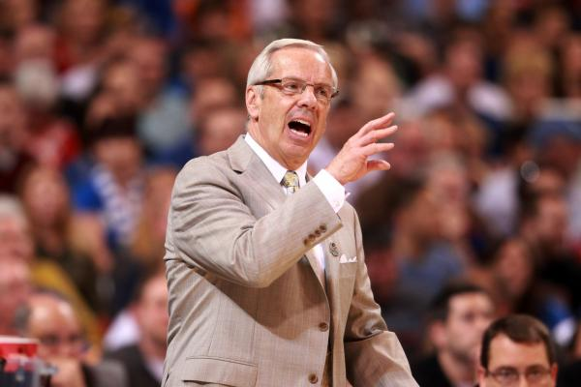
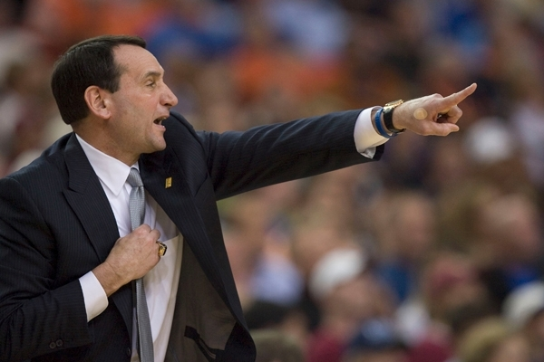

Slide 3
BE what you ARE!

Slide 4
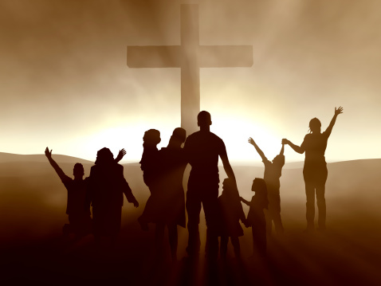
BE what you ARE!

Slide 5
Colossians 3:5-17

Slide 6
Colossians 3:11
“Here there is not Greek and Jew, circumcised and uncircumcised, barbarian, Scythian, slave, free; but Christ IS all, and IN all.”

Slide 7
Colossians 3:12
“Put on then, as God's chosen ones, holy and beloved, compassionate hearts, kindness, humility, meekness, and patience”

Slide 8
Colossians 3:5-17
“BE what you ARE!”
Are you Chosen of God?

Slide 9
Colossians 3:5-17
“BE what you ARE!”
Are you Holy?

Slide 10
Colossians 3:5-17
“BE what you ARE!”
Are you Loved?

Slide 11
Colossians 3:5-10
“Put to death therefore what is earthly in you: sexual immorality, impurity, passion, evil desire, and covetousness, which is idolatry. On account of these the wrath of God is coming. In these you too once walked, when you were living in them. But now you must put them all away: anger, wrath, malice, slander, and obscene talk from your mouth. Do not lie to one another, seeing that you have put off the old self with its practices and have put on the new self, which is being renewed in knowledge after the image of its creator.”

Slide 12
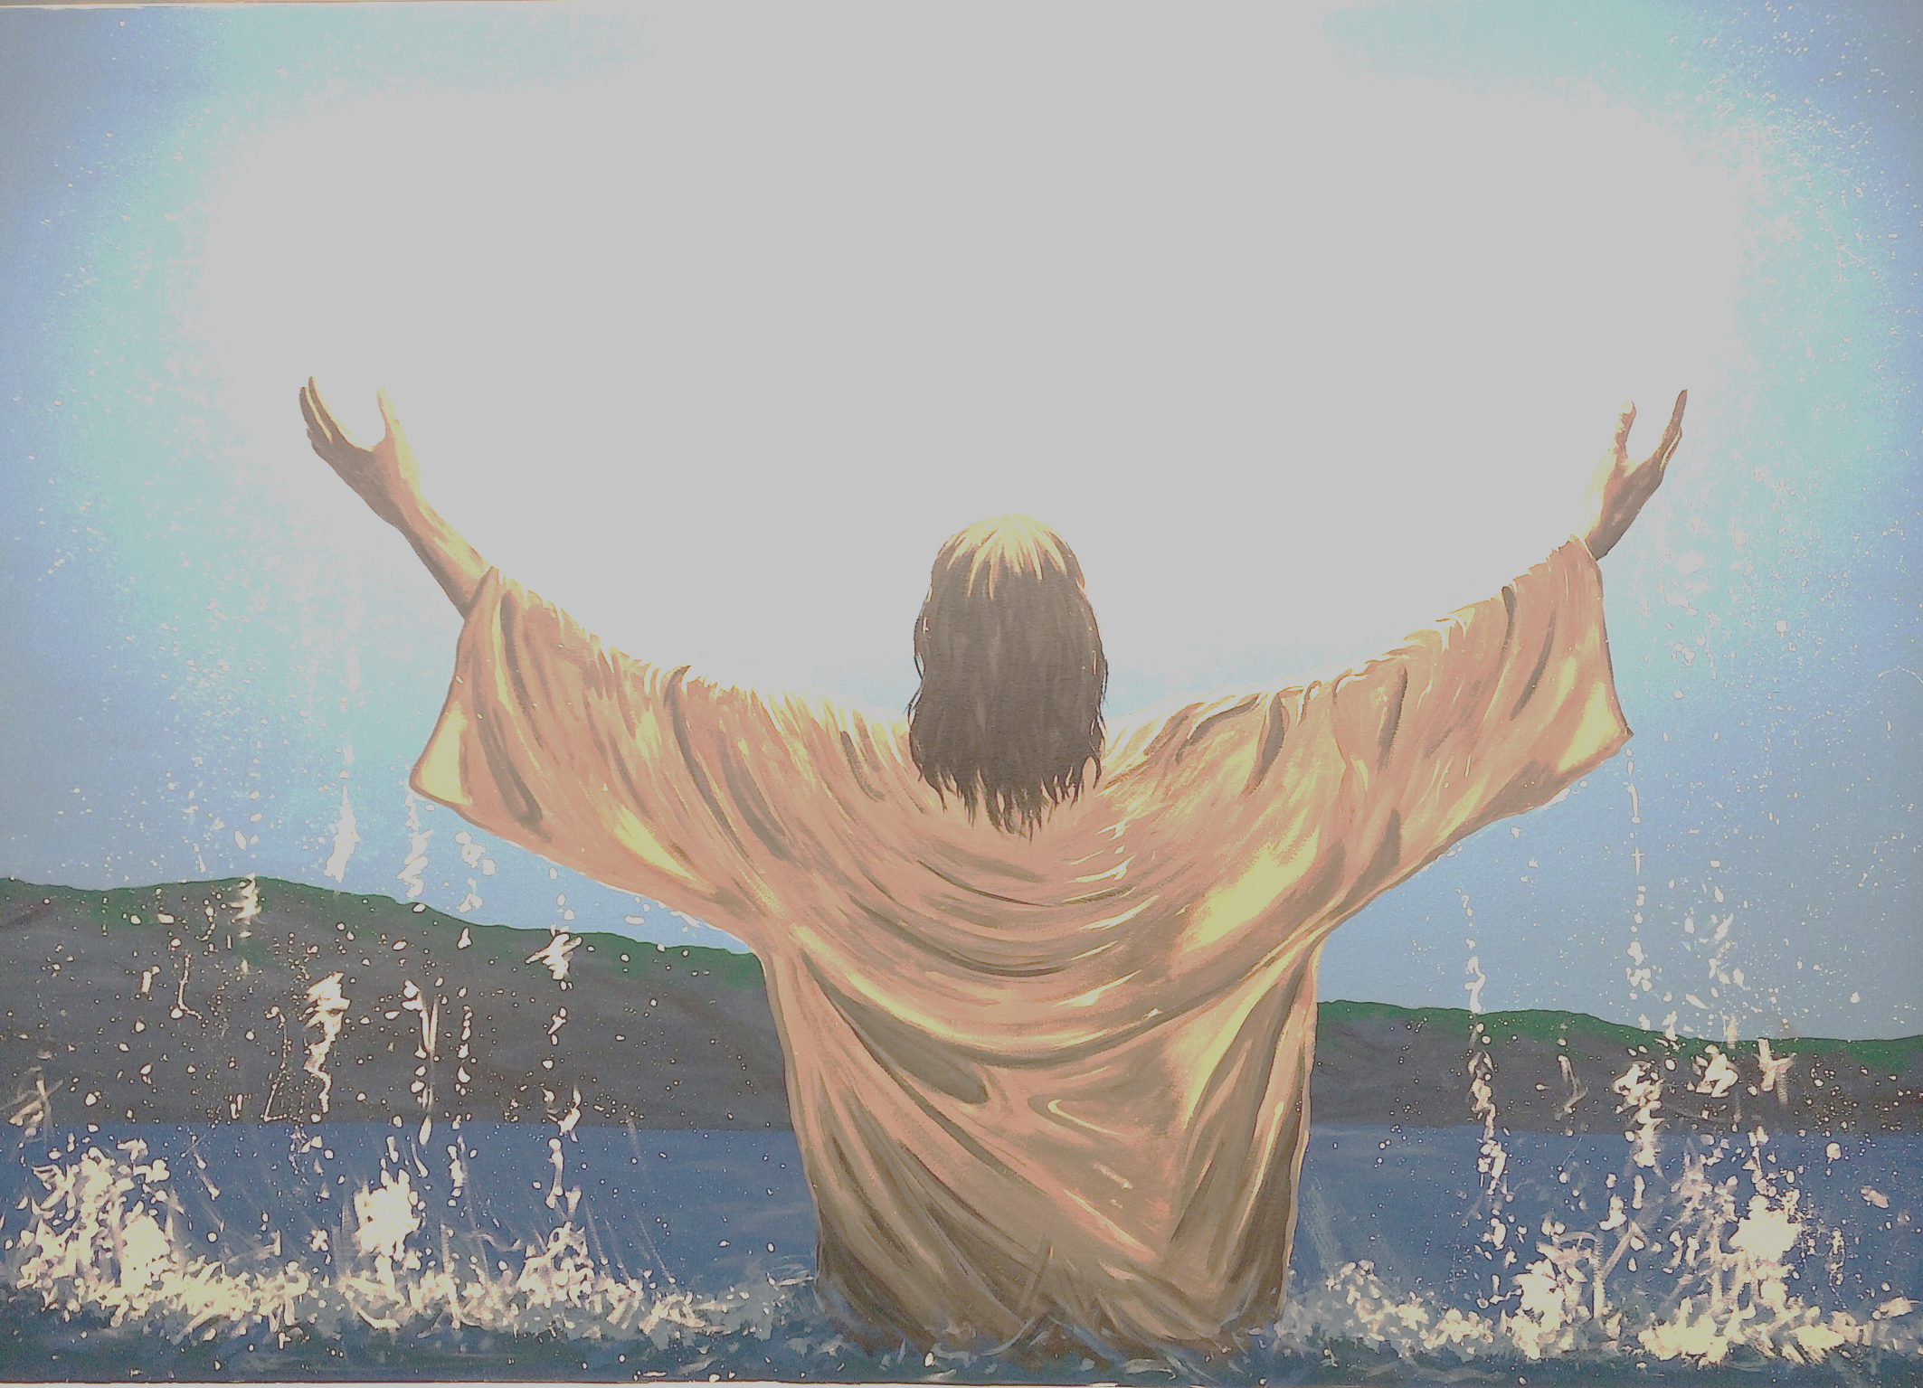
“Citizens of Heaven

Slide 14
WHEN JESUS IS AT THE CENTER

Slide 15
Colossians 3:5-10
“Put to death therefore what is earthly in you: sexual immorality, impurity, passion, evil desire, and covetousness, which is idolatry. On account of these the wrath of God is coming. In these you too once walked, when you were living in them. But now you must put them all away: anger, wrath, malice, slander, and obscene talk from your mouth. Do not lie to one another, seeing that you have put off the old self with its practices and have put on the new self, which is being renewed in knowledge after the image of its creator.”

Slide 16
Colossians 3:5-10
“Put to death therefore what is earthly in you: sexual immorality, impurity, passion, evil desire, and covetousness, which is idolatry. On account of these the wrath of God is coming. In these you too once walked, when you were living in them.

Slide 17
Colossians 3:5-10
But now you must put them all away: anger, wrath, malice, slander, and obscene talk from your mouth. Do not lie to one another, seeing that you have put off the old self with its practices and have put on the new self, which is being renewed in knowledge after the image of its creator.”

Slide 18
Put to death
Put away
SEXUAL?
ANGER?

Slide 19
Colossians 3:5-17
“BE what you ARE!”

Slide 20
Colossians 3:12
“Put on then, as God's chosen ones, holy and beloved, compassionate hearts, kindness, humility, meekness, and patience,”

Slide 23
Colossians 3:12
“Put on then, as God's chosen ones, holy and beloved, compassionate hearts, kindness, humility, meekness, and patience”

Slide 24
Colossians 3:15-17
“And let the peace of Christ rule in your hearts, to which indeed you were called in one body. And be thankful.
Let the word of Christ dwell in you richly, teaching and admonishing one another in all wisdom, singing psalms and hymns and spiritual songs, with thankfulness in your hearts to God.
And whatever you do, in word or deed, do everything in the name of the Lord Jesus, giving thanks to God the Father through him.”
L O V E

Slide 26
Colossians 3:5-17
“BE what you ARE!”
CHOSEN - HOLY - LOVED

