Slide 2
“Christianity Begins at Home”

Slide 8
Colossians 3:18-21(ESV)
¹⁸Wives, submit to your husbands, as is fitting in the Lord. ¹⁹Husbands, love your wives, and do not be harsh with them. ²⁰Children, obey your parents in everything, for this pleases the Lord. ²¹Fathers, do not provoke your children, lest they become discouraged.

Slide 9
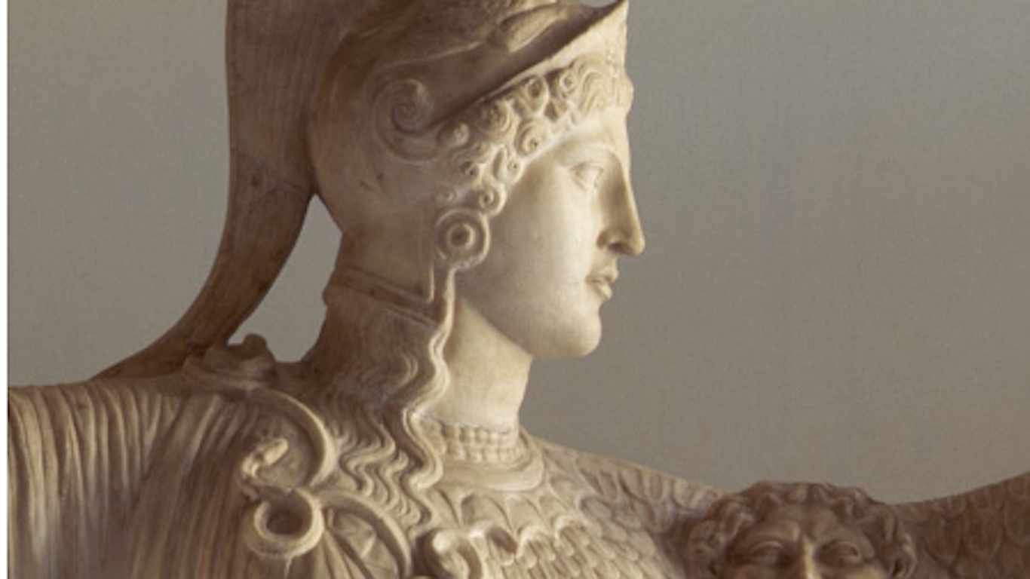
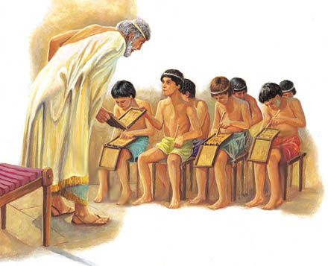
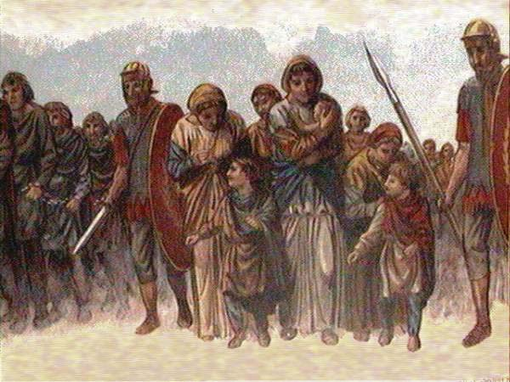
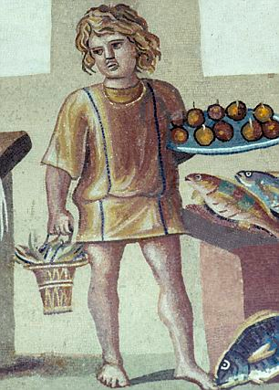

Slide 10
Colossians 3:18-21(ESV)
¹⁸Wives, submit to your husbands, as is fitting in the Lord. ¹⁹Husbands, love your wives, and do not be harsh with them. ²⁰Children, obey your parents in everything, for this pleases the Lord. ²¹Fathers, do not provoke your children, lest they become discouraged.

Slide 11
“ . . . . as is fitting in the Lord.”
- 3:18

Slide 12
“ . . . . for this pleases the Lord.” - 3:20

Slide 13
“ . . . . fearing the Lord.”
- 3:22

Slide 14
“ . . . . work heartily, as for the Lord.”
- 3:23

Slide 15
“You are serving the Lord Christ.”
- 3:24

Slide 16
JESUS

Slide 17
¹² Put on then, as God's chosen ones, holy and beloved, compassionate hearts, kindness, humility, meekness, and patience,
¹³ bearing with one another and, if one has a complaint against another, forgiving each other; as the Lord has forgiven you, so you also must forgive.
- Colossians 3:12-13

Slide 18
¹² Put on then, as God's chosen ones, holy and beloved, compassionate hearts, kindness, humility, meekness, and patience,
¹³ bearing with one another and, if one has a complaint against another, forgiving each other; as the Lord has forgiven you, so you also must forgive.
- Colossians 3:12-13

Slide 19
lest they become discouraged

Slide 21
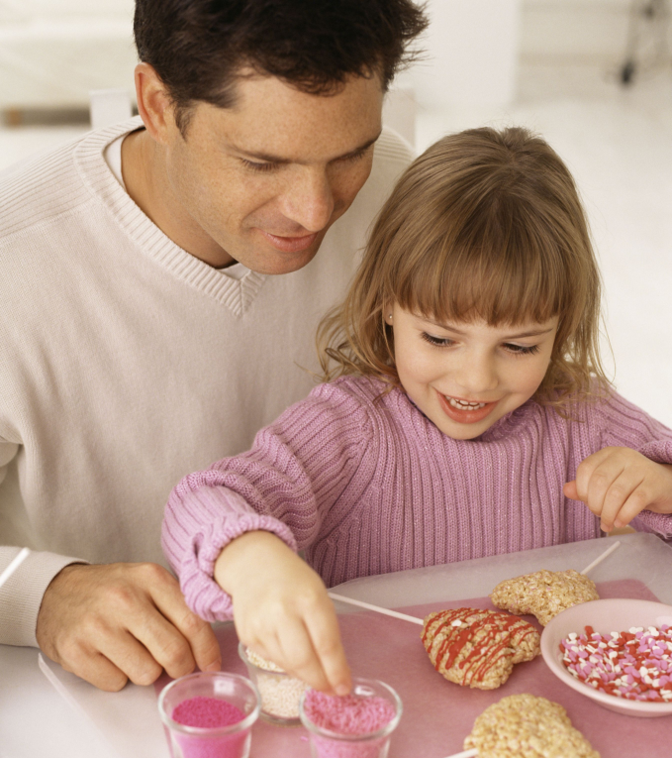
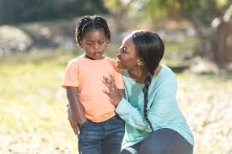

Slide 22
lest they become discouraged

Slide 23
