Slide 2
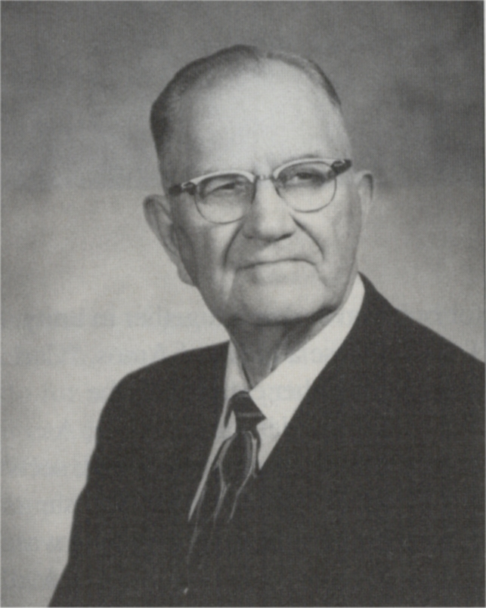
“The world has lost the right of prayer, and saints have failed to pray; what loss sustained beyond repair! How blind of heart are they! The Father speaketh in His word, He talks no other way! And to converse with Him, our Lord, we must take time to pray! There is no trial, grief, or pain, no moment of the day, but that we may in Jesus’ name incline our souls to pray!”
L.O. Sanderson
1901-1992

Slide 3
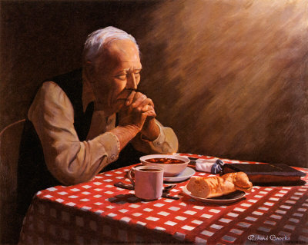

Slide 5
²Continue steadfastly in prayer, being watchful in it with thanksgiving.
³At the same time, pray also for us, that God may open to us a door for the word, to declare the mystery of Christ, on account of which I am in prison—
⁴that I may make it clear, which is how I ought to speak.
⁵Walk in wisdom toward outsiders, making the best use of the time.
⁶Let your speech always be gracious, seasoned with salt, so that you may know how you ought to answer each person.
- Colossians 4:2-6

Slide 6
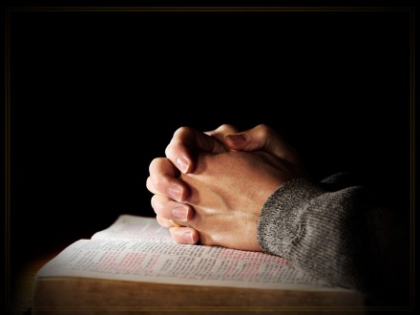
What To Pray For?

Slide 7
PRAY . . . . . WATCH . . . . . GIVE THANKS
²Continue steadfastly in prayer, being watchful in it with thanksgiving.
³At the same time, pray also for us, that God may open to us a door for the word, to declare the mystery of Christ, on account of which I am in prison—
⁴that I may make it clear, which is how I ought to speak.
⁵Walk in wisdom toward outsiders, making the best use of the time.
⁶Let your speech always be gracious, seasoned with salt, so that you may know how you ought to answer each person.
- Colossians 4:2-6

Slide 9
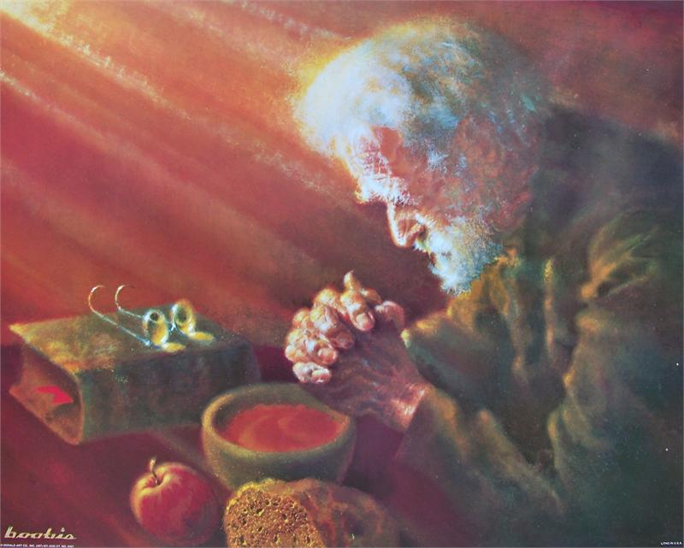
Persisitent
Determined
Faithful
PRAYER

Slide 10
²Continue steadfastly in prayer, being watchful in it with thanksgiving.
³At the same time, pray also for us, that God may open to us a door for the word, to declare the mystery of Christ, on account of which I am in prison—
⁴that I may make it clear, which is how I ought to speak.
⁵Walk in wisdom toward outsiders, making the best use of the time.
⁶Let your speech always be gracious, seasoned with salt, so that you may know how you ought to answer each person.
- Colossians 4:2-6

Slide 11
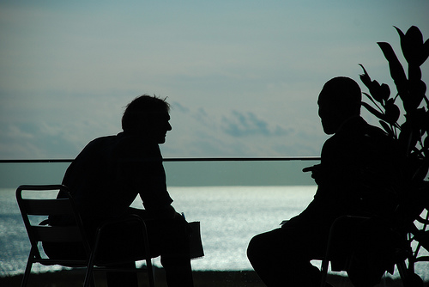

Slide 12
PRAY . . . . . WATCH . . . . . GIVE THANKS

Slide 13
PRAYER + PROCLAMATION = EVANGELISM

Slide 14
²Continue steadfastly in prayer, being watchful in it with thanksgiving.
³At the same time, pray also for us, that God may open to us a door for the word, to declare the mystery of Christ, on account of which I am in prison—
⁴that I may make it clear, which is how I ought to speak.
⁵Walk in wisdom toward outsiders, making the best use of the time.
⁶Let your speech always be gracious, seasoned with salt, so that you may know how you ought to answer each person.
- Colossians 4:2-6

Slide 15
Would you pray for us?

Slide 16
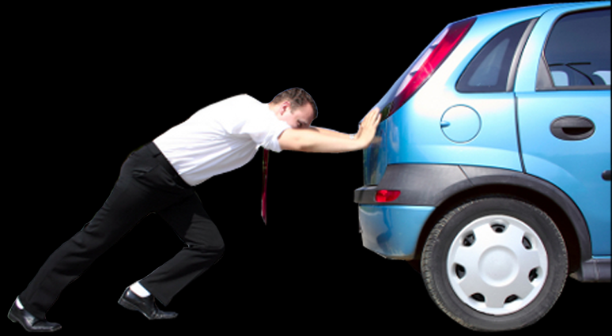

Slide 18
Continue Steadfastly in Prayer!

Slide 19
PRAY
WATCH
GIVE THANKS

