Slide 2
“If no one cares, you are truly alone”

Slide 4
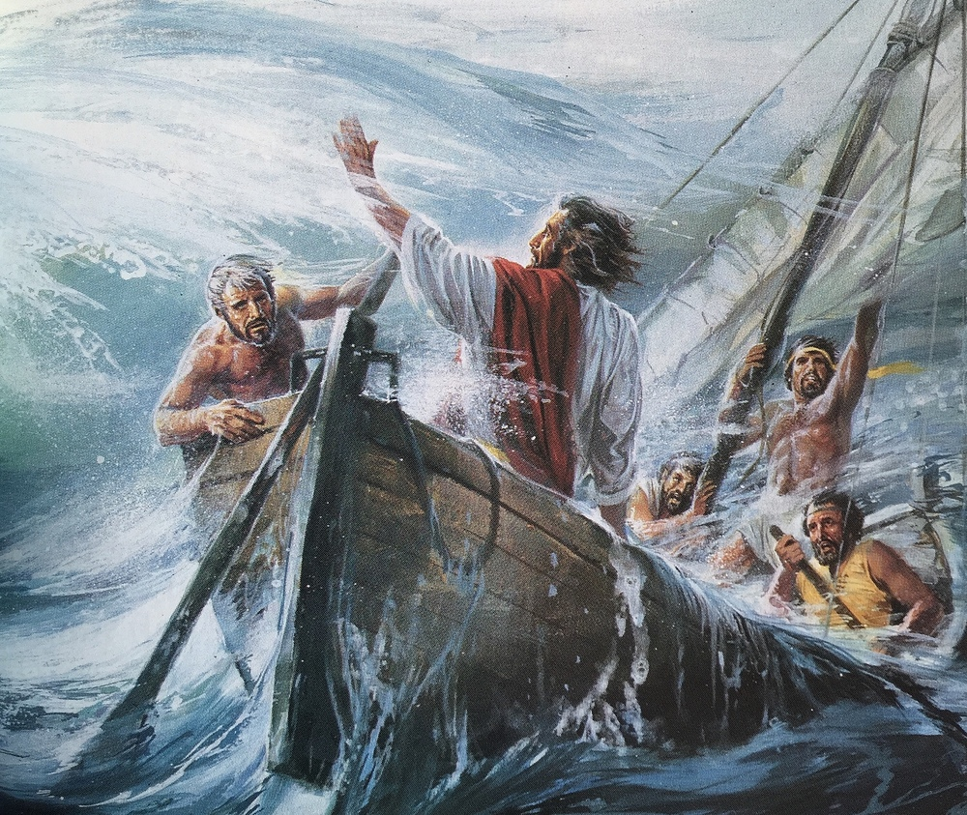

Slide 5
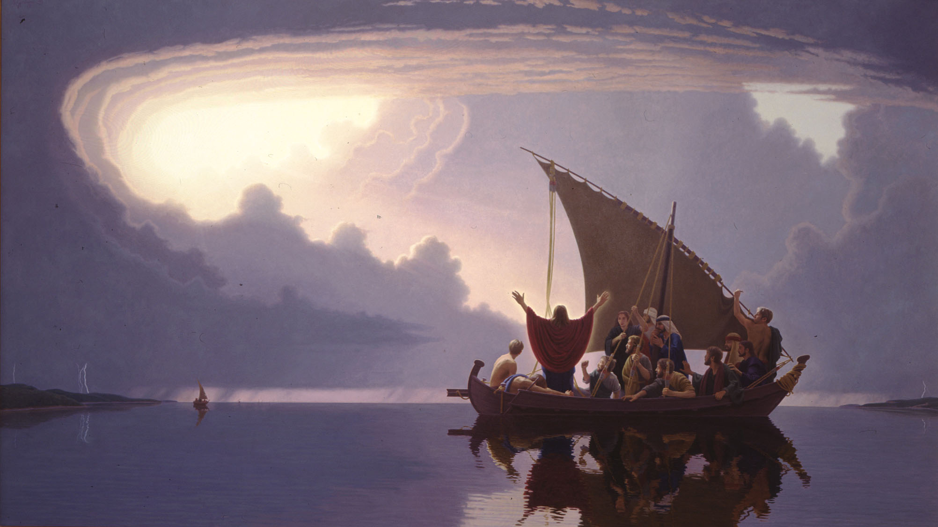

Slide 7
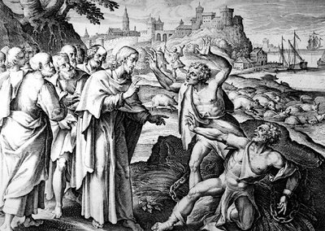

Slide 8
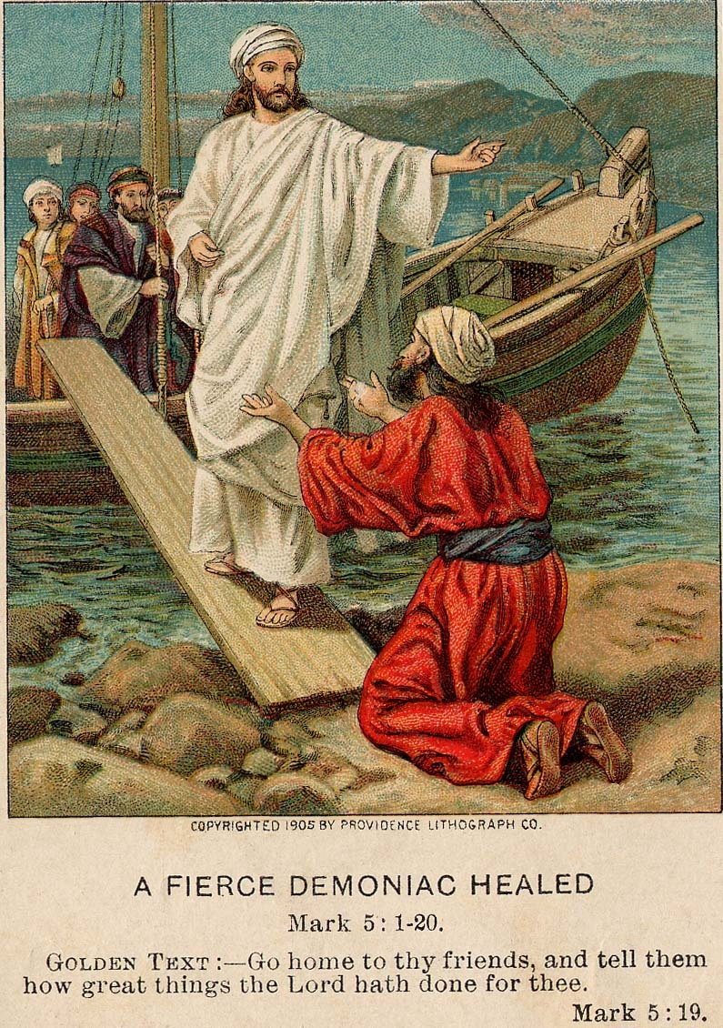
“Go home to your friends and tell them how much the Lord has done for you, and how he has had mercy on you.”

Slide 9
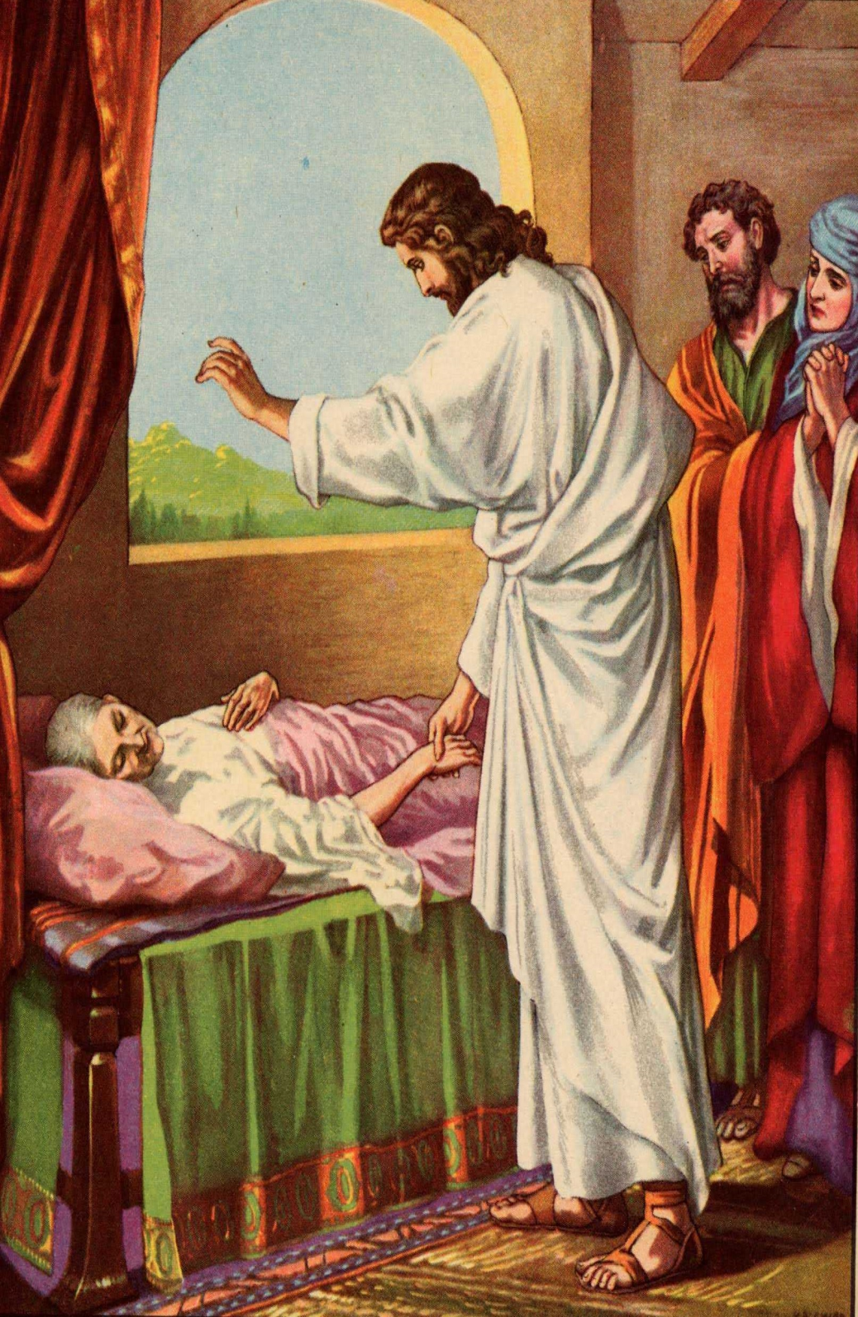
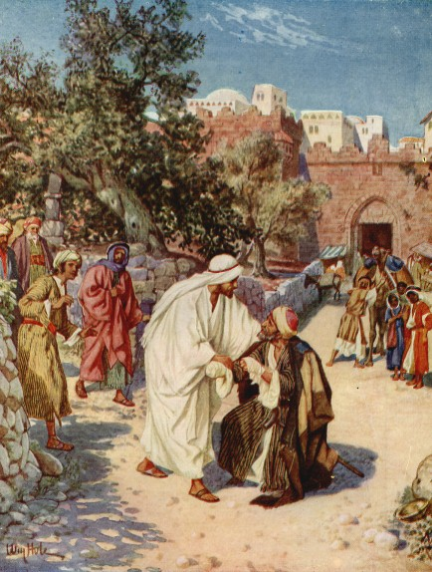
“DOES JESUS CARE?”

Slide 10
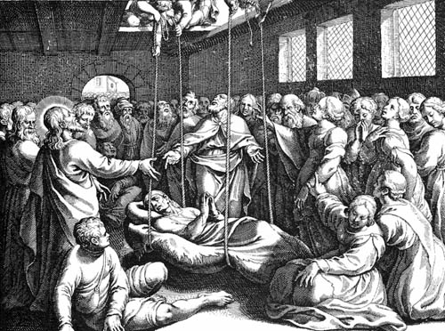

Slide 11
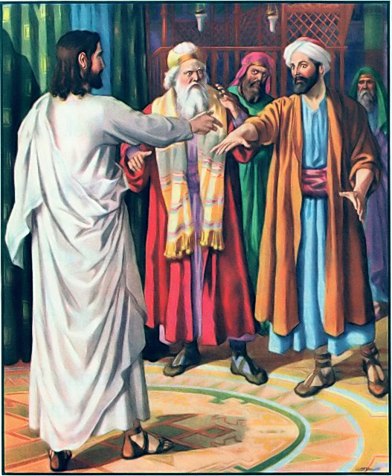
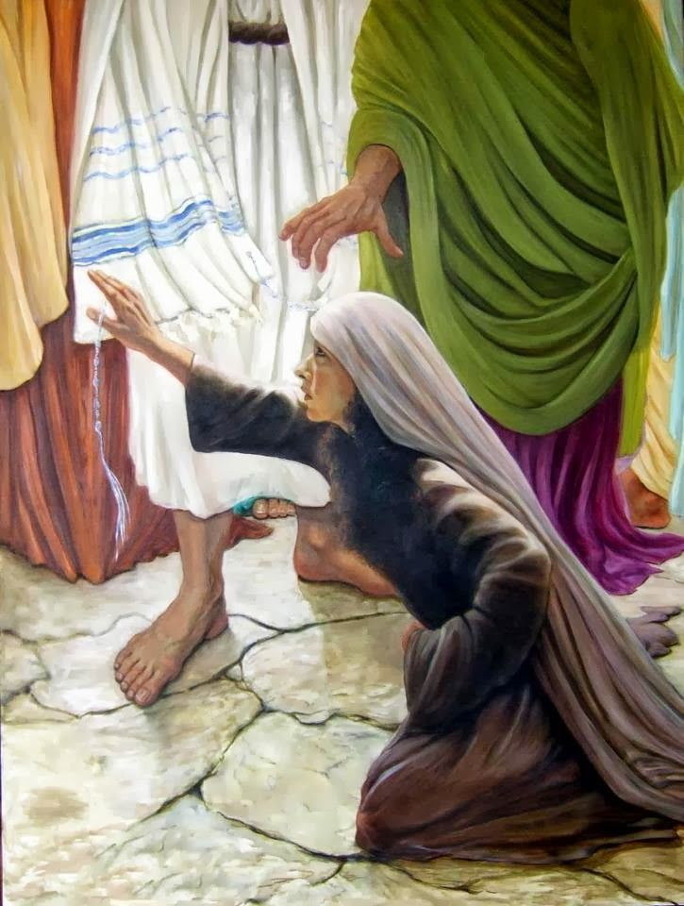
“DOES JESUS CARE?”

Slide 12
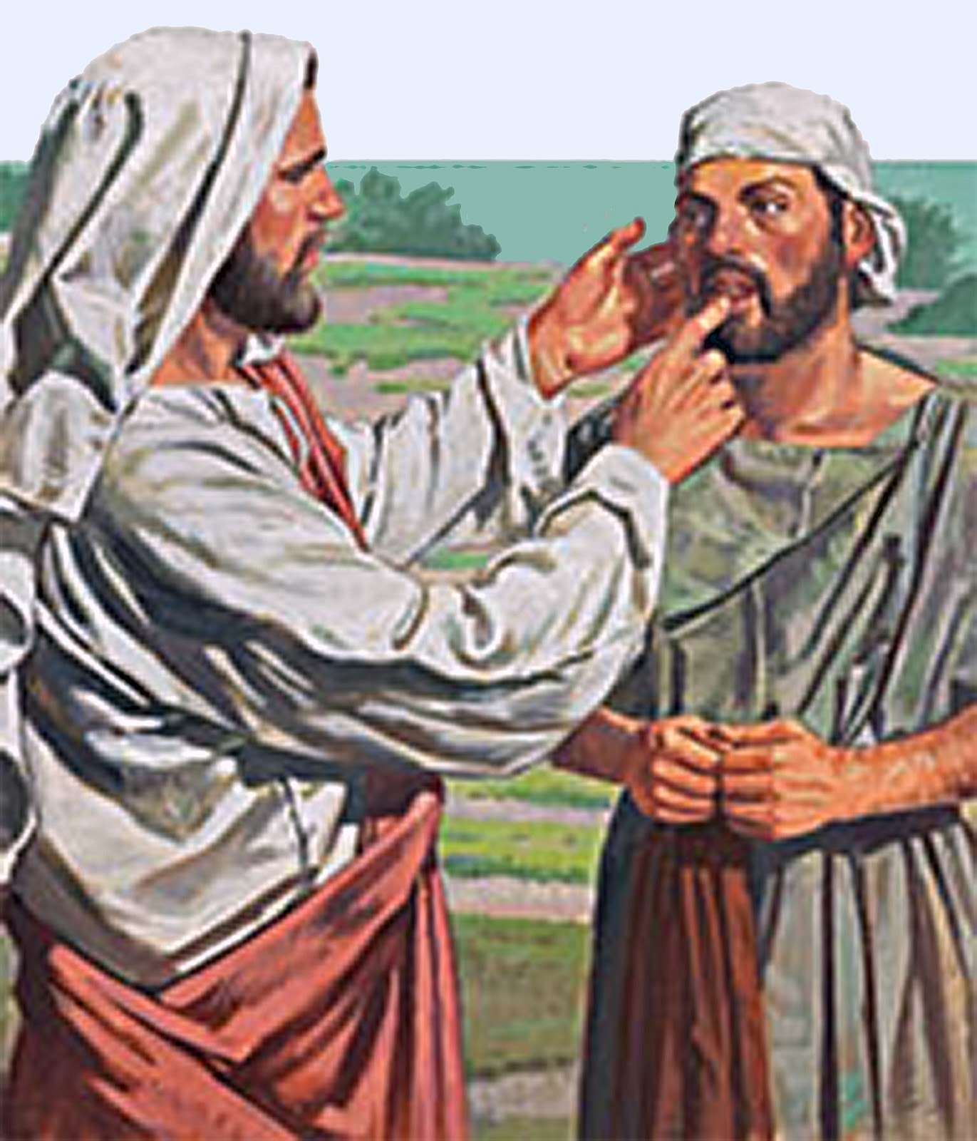
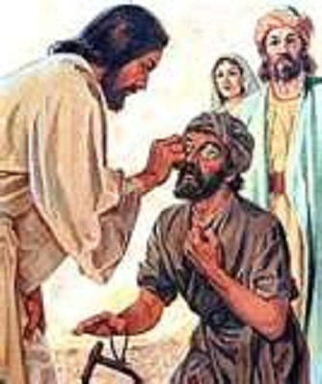

Slide 13
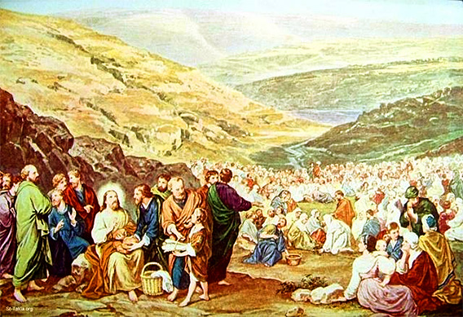
“Does Jesus care – even when people are hungry?”

Slide 14
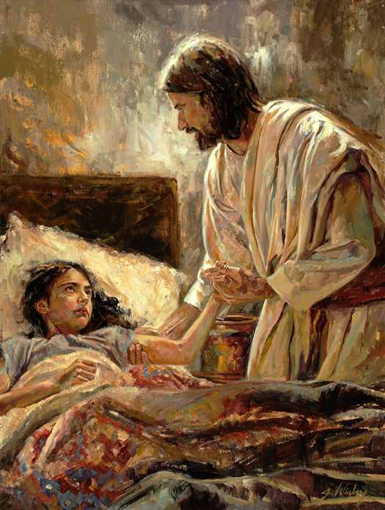
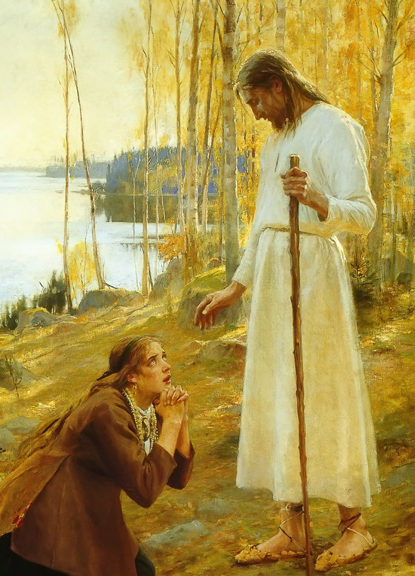
“DO YOU CARE?”

Slide 15
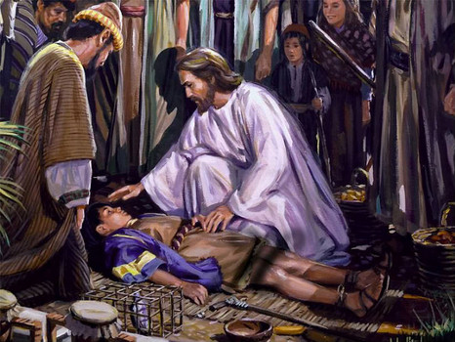
“DOES JESUS CARE?”

Slide 16
^{MARK 10:13-16}
¹³ And they were bringing children to him that he might touch them, and the disciples rebuked them.
¹⁴ But when Jesus saw it, he was indignant and said to them, “Let the children come to me; do not hinder them, for to such belongs the kingdom of God.
¹⁵ Truly, I say to you, whoever does not receive the kingdom of God like a child shall not enter it.”
¹⁶ And he took them in his arms and blessed them, laying his hands on them.

Slide 18
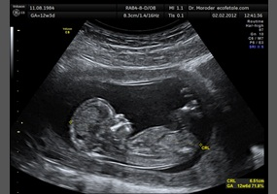
“Does Jesus care - about the unborn child?”

Slide 19
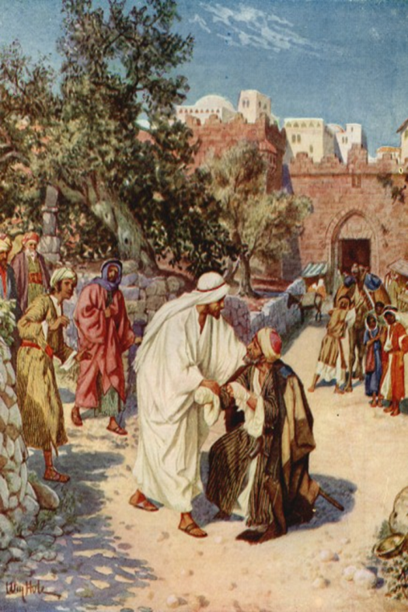

Slide 20
