Slide 2
Genesis 37-50

Slide 3
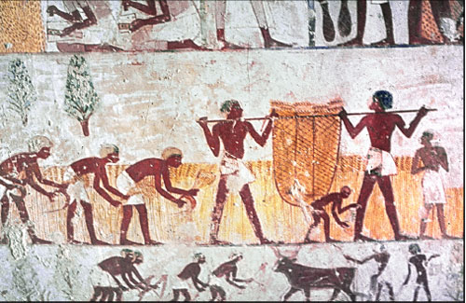
“”The Peril of Freedom”

Slide 4
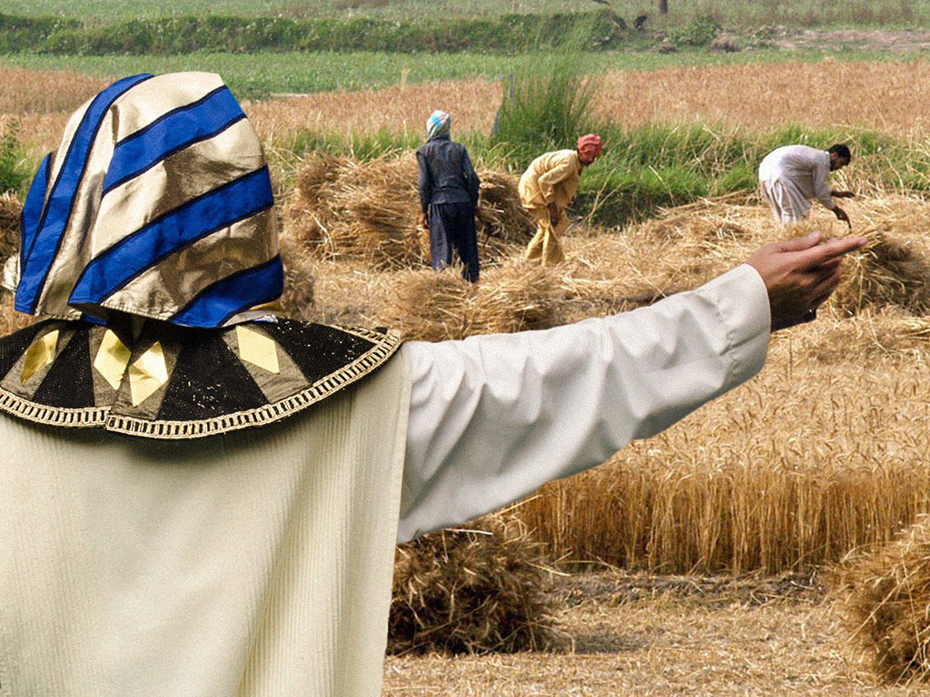

Slide 5
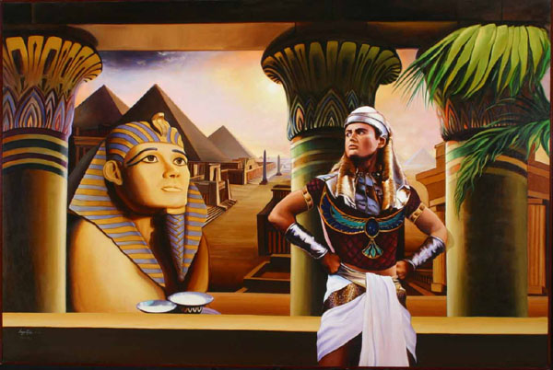

Slide 8
“THE PERIL OF FREEDOM”

Slide 10
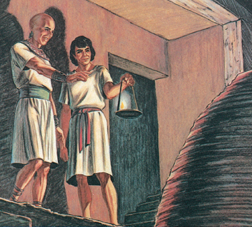

Slide 11
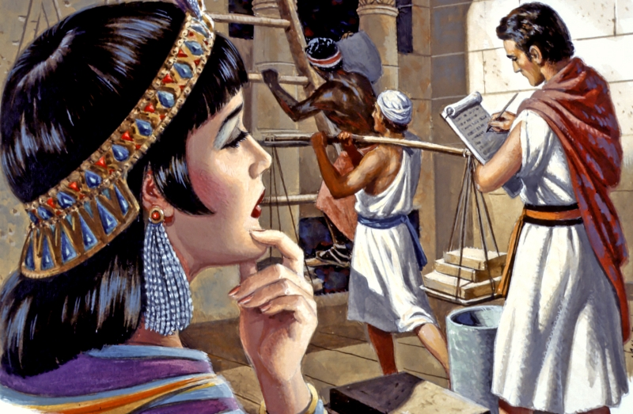

Slide 12
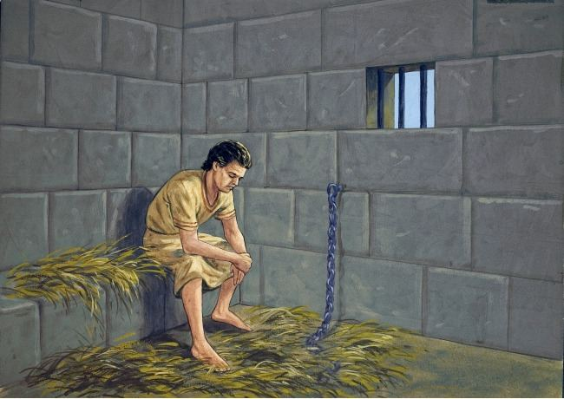

Slide 13
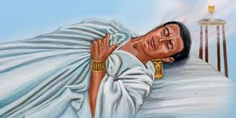

Slide 14
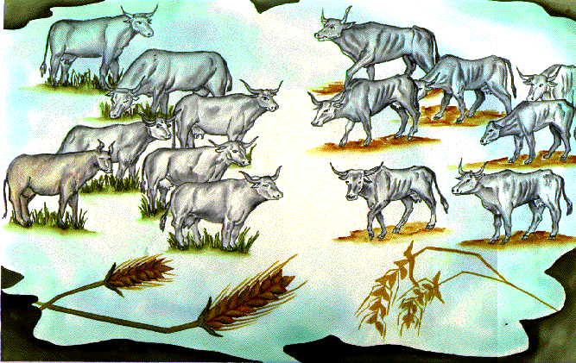

Slide 15
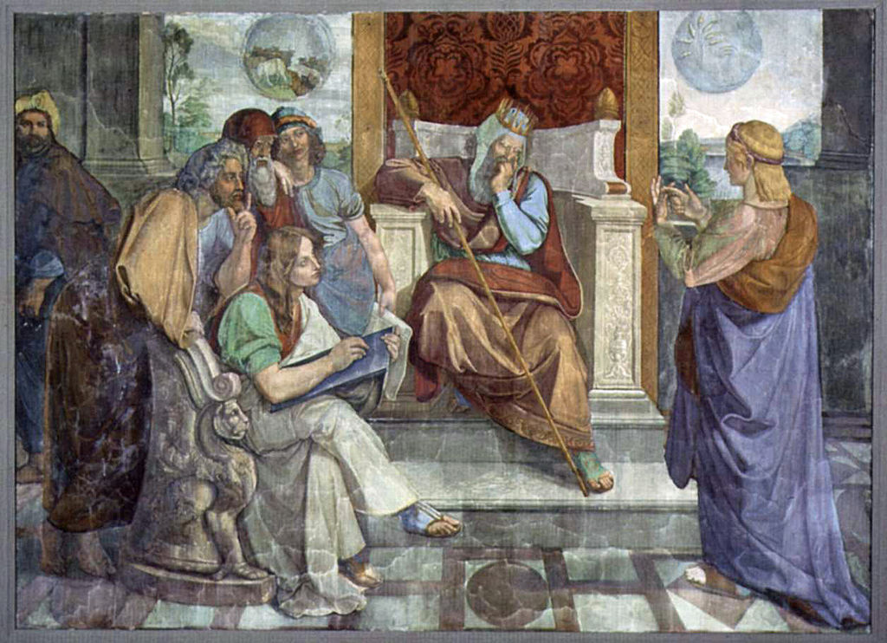
“It is not in me, God will give Pharaoh a favorable answer.”

Slide 16
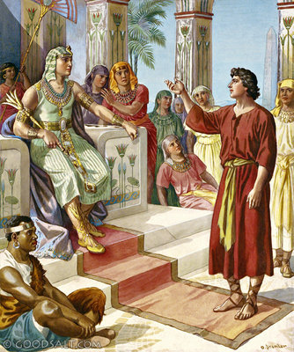
²⁵ Then Joseph said to Pharaoh, “The dreams of Pharaoh are one; God has revealed to Pharaoh what he is about to do.
²⁶ The seven good cows are seven years, and the seven good ears are seven years; the dreams are one.
²⁷ The seven lean and ugly cows that came up after them are seven years, and the seven empty ears blighted by the east wind are also seven years of famine.
²⁸ It is as I told Pharaoh; God has shown to Pharaoh what he is about to do.

Slide 17
²⁹ There will come seven years of great plenty throughout all the land of Egypt,
³⁰ but after them there will arise seven years of famine, and all the plenty will be forgotten in the land of Egypt. The famine will consume the land,
³¹ and the plenty will be unknown in the land by reason of the famine that will follow, for it will be very severe.
³² And the doubling of Pharaoh's dream means that the thing is fixed by God, and God will shortly bring it about.

Slide 18
³³ Now therefore let Pharaoh select a discerning and wise man, and set him over the land of Egypt.
GENESIS 41:25-33

Slide 19
³⁸ And Pharaoh said to his servants, “Can we find a man like this, in whom is the Spirit of God?”
³⁹ Then Pharaoh said to Joseph, “Since God has shown you all this, there is none so discerning and wise as you are.
⁴⁰ You shall be over my house, and all my people shall order themselves as you command. Only as regards the throne will I be greater than you.”
⁴¹ And Pharaoh said to Joseph, “See, I have set you over all the land of Egypt.”

Slide 20
⁴² Then Pharaoh took his signet ring from his hand and put it on Joseph's hand, and clothed him in garments of fine linen and put a gold chain about his neck.
⁴³ And he made him ride in his second chariot. And they called out before him, “Bow the knee!” Thus he set him over all the land of Egypt.
⁴⁴ Moreover, Pharaoh said to Joseph, “I am Pharaoh, and without your consent no one shall lift up hand or foot in all the land of Egypt.”

Slide 21
⁴⁵ And Pharaoh called Joseph's name Zaphenath-paneah. And he gave him in marriage Asenath, the daughter of Potiphera priest of On. So Joseph went out over the land of Egypt.
⁴⁶ Joseph was thirty years old when he entered the service of Pharaoh king of Egypt. And Joseph went out from the presence of Pharaoh and went through all the land of Egypt.
GENESIS 41:38-46

Slide 22
“GOD”

Slide 23
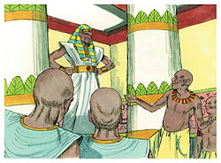
Genesis 41:55
⁵⁵ When all the land of Egypt was famished, the people cried to Pharaoh for bread. Pharaoh said to all the Egyptians, “Go to Joseph. What he says to you, do.”

Slide 24
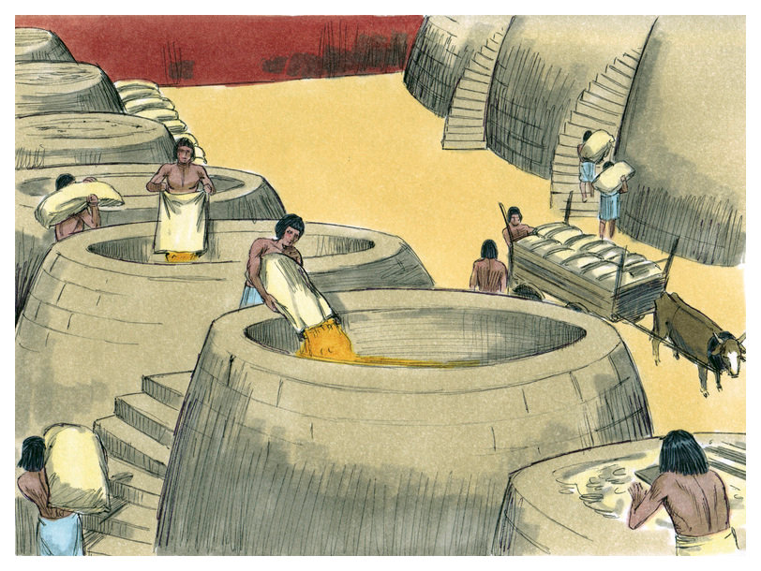
Genesis 41:57
⁵⁷ Moreover, all the earth came to Egypt to Joseph to buy grain, because the famine was severe over all the earth.

Slide 25
SEEK THE FACE OF GOD!

Slide 27
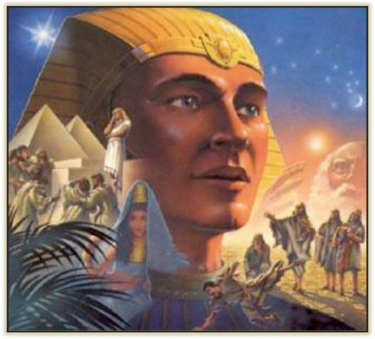

Slide 29
